Slide 1
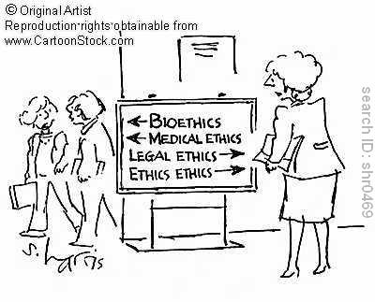
Adolescence, ethics, and legal issues
Updated July 2016

Slide 2
Module A4 Goal I
Understand how the issues raised by the UN Convention on the Rights of the Child relate to one’s particular practice with adolescents

Slide 3
Conceptual frameworks
Integrating Paradigms
Legal framework
Core bioethics principles
Human rights framework
Developmental approaches

Slide 4
What is special about adolescents?
Often economically dependent on their parents
Moving towards autonomy
Issues of maturity/competence
Issues of confidentiality
Not all young people are at the same developmental stage at any given chronological age
Issues of competence and consent
Decisions may have profound and long lasting consequences
Difficulties in recognizing long-term consequenses
Organization of service delivery
Ethics of preventive interventions

Slide 5
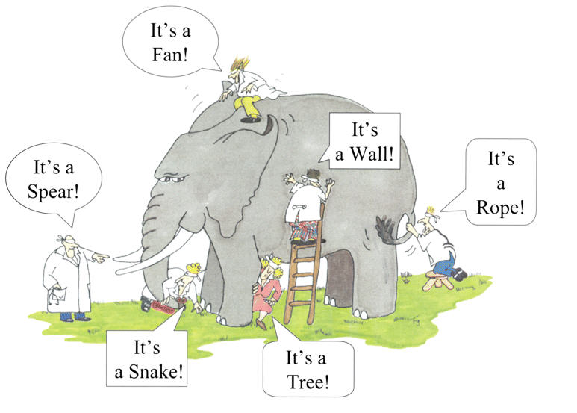
When do young people reach…
age of majority
age of sexual consent
right to treatment consent
right to treatment veto
right to confidential care
in your country?
DK
18

Slide 6
Some bioethical issues in adolescent health
unplanned/unwanted pregnancy
prevention of STIs
sexual abuse and sexual violence
genital mutilation
disclosure of information to a dying patient
testing urine for the presence of drugs
breaking confidentiality in a potentially lethal situation
hospitalizing an anorexic patient against his/her will

Slide 7
Legal Frameworks
Age concepts
Age of “majority” is the threshold of adulthood as it is conceptualised in law. It is the chronological moment when minors legally take control over themselves, their actions and decisions, thereby terminating the legal control and legal responsibilities of their parents over them.
Age of “license” is the age at which the law permits an individual to perform specific acts and exercise certain rights, with or without any restrictions.

Slide 8
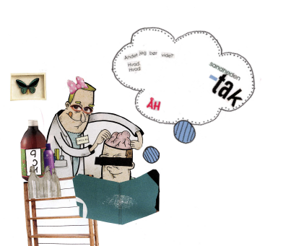
Bioethics Principles
Respect for people (autonomy and informed consent)
Beneficience
Non-maleficience
Justice
Anything else,
I should know?
The truth, please.
Beauchamp & Childress
Notes:
I like to formulation

Slide 9
Bioethics Principles
Beneficence
Maximize benefits & minimize harms
Balancing burdens and benefits
“Best Interests”
Key issues
  Who decides? Providers? Adolescents? Parents?
  Quality of life
  Conflicts with autonomy
Notes:
While in adult medicine, autonomy reigns supreme, In pediatrics, Beneficence often trumps autonomy

Slide 10
Bioethics Principles
Justice
Fairness; treating like persons alike
Operates on multiple levels
  Societal level: Resource allocation, health policy and universal health insurance
  Individual level: Health disparities

Slide 11
Trends
Applying bioethics to other contexts than that of research (e.g. clinical care and public health) means relying on additional values, such as
dignity
integrity
solidarity
participation
vulnerability
        Barcelona declaration, 2002

Slide 12
The convention of the rights of the child
the right to be heard (art. 12)
the right to express his own rights and the right for autonomy (art. 12 & 14)
the right to privacy (art. 16)
the best interest of the child (art. 3)
the right to be protected from violence (art. 23)
the right not to be discriminated against (art 2)

Slide 13
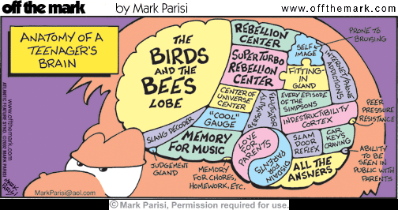
Developmental Approaches
Psychological changes
From concrete to abstract thinking
From short to long term perspective
Identity forming
Social changes
Individuation
Youth life
Future
13

Slide 14
A QUOTE…
“competence” is a legal term. People are competent or incompetent to consent when a court says they are. The better term to use when considering assessment in this area is “capacities” or “abilities ”. The clinician concludes that the individual has sufficient capacities to make an autonomous choice. The clinician’s notion of what is “sufficient” is informed by the clinician’s understanding of legal definitions of competence, but the clinician’s decision does not make the person legally competent. Thus, “tools” for assessing adolescents’ capacities for treatment decision making should measure concepts that make sense from both a legal and a clinical (developmental) perspective
Th. Grisso

Slide 15
A few definitions…
In French: competence defined as «capacité de discernement»
Competence is a legal term: the ability to understand information presented, to appreciate the consequences of acting (or not acting) on that information, and to make a choice ; in some settings, while a child may possess competence in regard to a particular matter, their parent / guardian may still have the right to override their decision
Capacity: is a medical concept and refers to an individual's psychological abilities to understand, appreciate, and manipulate information to form and express a decision (health care)
In Australia, ‘capacity’ is a legal concept that describes the level of intellectual functioning of a person to accept responsibility for important decisions that have legal consequences
Deepa L. Persad / WHO, in procress

Slide 16
A few definitions…
Minor: before an individual legally attains the status of an adult, →automatically emancipated from parental custody/control
Emancipated minor : process of freeing a minor from parental control; legally entitled to make almost all of his or her own decisions (e.g. marriage)
Mature minor: the “mature minor” doctrine is a statutory, regulatory, or policy that recognises that a minor is allowed to consent or refuse to consent to his medical treatment provided he has sufficiently maturity to understand, discern and appreciate the benefits and risks of the proposed treatment
Assent: the right to express one’s views freely. Agreement to undergo a procedure or participate in research. or clinical care (in writing or implied / tacit)
Deepa L. Persad / WHO, in procress

Slide 17
Module A4 Goal II
Understand and apply the concepts of ‘confidentiality’ and ‘informed consent’ to one’s practice when dealing with adolescents

Slide 18
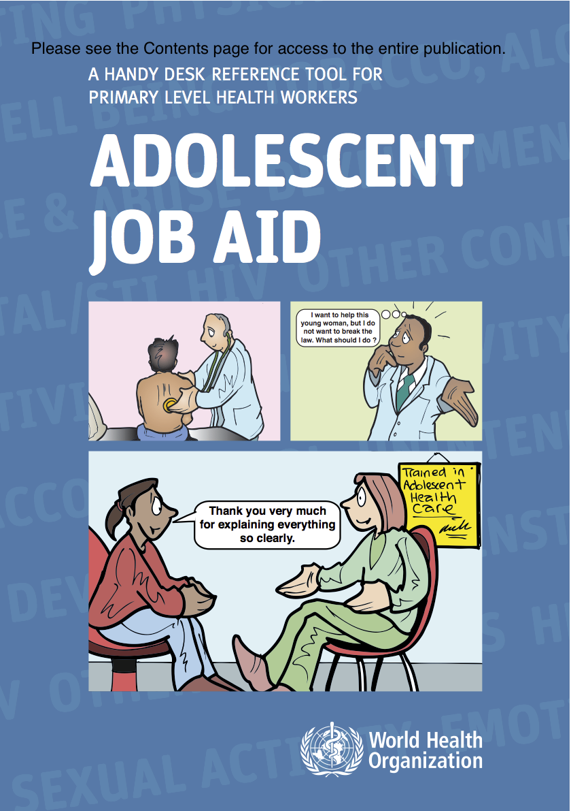
I want to help this young woman but I don’t want to break the law
What should I do?
http://www.who.int/maternal_child_adolescent/documents/9789241599962/en/index.html

Slide 19
Confidentiality and rights
Confidentiality -One corner-stone in Adolescent –friendly-services
UN convention on the rights of the child is an universal framework
Human rights convention another
National legal aspects and cultural issues are involved

Slide 20

Different frameworks/lenses
- 3 important Cs
Confidentiality
Consent
Competence

Slide 21

Confidentiality
Any ‘competent’ person has the right to demand that his/her health care provider does not disclose any information to any other person, unless he/she has been given express permission to do so by the patient.

Slide 22
Limits to confidentiality
Risk of suicide
Risk of homicide
Sexual abuse, substance abuse or other serious signs of a harmful life style
Reportable disease
The patient might be either a victim or a perpetrator!

Slide 23
Confidential care for minors
Law
Limits of confidentiality
  within the context of care
Respect adolescent’s growing need for intimacy and changing health needs
  More effective health care adapted to adolescent’s developmental stage
Evolving relationship with HCP
  Child with parents Adult
Sanci L et al 2005

Slide 24
How important is confidential care?
Needs explanations (study population context…)
Boisen et al. IAAH 2013

Slide 25
Effects of Confidentiality assurance
Number of students who believe that the doctor would keep confidentiality before and after confidentiality statement about
 | Before (%) | After(%)
Sex | 40 | 72
STI: diagnosis | 6 | 28
STI: treatment | 11 | 36
Regular tobacco use | 43 | 60
Ford et al. JAMA 1997

Slide 26
Safety & Access
With any limitations on confidentiality, adolescents are less willing to tell sensitive information
Effect of mandatory notification laws for birth control:
  59% would discontinue some or all clinic services or delay STI & HIV testing
  Only 30% of those using family planning clinics without their parent’s consent would continue use
Ford JAMA 1997; Reddy JAMA 2002; Jones JAMA. 2005

Slide 27
Teenager‘s expectations
“talking with doctor alone“ “confidentiality“
100
++
90
80
70
Expectations
60
++
Importance for 13- y-old
Percentaage
50
+
Importance for 15-y-old
40
+
Experiences
30
Offered by doctor to 13- y-old
20
Offered by doctor to 15-y-old
10
0
++: p<0.0001; +: p<0.01
Talking with doctor
alone
Confidentiality
assured
Rutishauser et al. Acta Paed 2003

Slide 28
Access to confidential health care
Teenagers are often unwilling to disclose sensitive health information to their parents
Influences willingness to seek health care (especially for vulnerable youth)
Rises the probability that the teenager will speak about delicate matters
Ford et al. JAMA 1997

Slide 29
Mature minor principle
An adolescent under 18 is capable of giving informed consent
when he or she « achieves a sufficient understanding and intelligence to enable him or her to understand fully what is proposed »
Correlation with developmental issues and growing capacity of adolescents of making informed choices
Endorsed by many countries
Confidential health care for adolescents: reconciling clinical evidence with family values
Sanci L Med Journal of Australia, 2005

Slide 30
Parents IN?
Or Parents OUT?

Slide 31

Confidentiality vs. connectednes
The rights of the parents to know (to care)
The rights of the adolescent not to have others know

Slide 32
And the parents?
Between rights and responsibilities….
Parental rights
Young people’s rights
Duty to protect
young people
Desire to make
own decisions
Young people’s
cognitive abilities
not fully developped:
Ex: decision making,
selecting relevant information,…
Growing ability to
make competent decisions
Vic Larcher, BMJ 2007

Slide 33
The medical consultation
With parents
History taking
Confidentiality and its limits
( why it is important for adolescent development)
Program
Who is the patient?
What is the problem?
Keep family life cycles in mind
Adolescent alone
What brings him/her
Confidentiality (to be reminded at beginning and when addressing sensitive issues)
HEADSSS
Systems review
Sleep, eating habits
Thorough body examination as opportunity to talk about body
Conclusions/what to tell parents
Notes:
Parenting skills are essential to healthy adolescent developemnt, family functionning can have impact on health symptoms es functional disorders or pain syndroms but also in chronic illnesses associated disability. Take every opportunity to meet parents and observe – Reseach is often focused on problems in families-and not on family protective factors.
To understand the problem you need parents and other peoples point of view

Slide 34
Parents beliefs and expectations
CON’s
Fear of not beeing informed on important information 44%
Child would not remember treatment plan 21%
Child not telling truth
Child would not want to see doctor alone 15%
PRO’S
Opportunity to talk about sensitive matters 71%
Doctor will hear my child’s point of view 63%
Practice for my child to talking to doctor alone 61%
Duncan R Journal of Adolescent Health 49 (2011)

Slide 35
Parents IN
AND
Parents OUT
Notes:
Take opportunity to asses families needing more specific intervention
Listen to families/siblings,…..a troubled adolescent affects the whole family.
Training in family therapy for HCP (basics)

Slide 36
Assessment by health professionals(1)
Caracteristics of the adolescent
age, young people’cognitive abilities, developpmental stage
ex:observing decision making capacity, selecting relevant information
Severity of health problem and nature of proposed treatment
    Assessment according to clinical problem: contraceptive use, surgical treatment, unwanted pregnancies,….

Slide 37
Assessment by health professionals(2)
Family values
    Assess capacity of parents of acting in a protective manner: developmentally appropriate respect for autonomy of children.
Legal and ethical exceptions
    Passing relevant information to specialist or emergengy care upon referral
    Neglect and abuse
    Self harm
    Harm against others

Slide 38
Assessment by health professionals(3)
    Many « in between »situations….
    Be well informed about local legal and ethical issues
    Have a practice policy document
    In case of difficult decisions identify colleagues you can share thoughts with
    DO NOT STAY ALONE…..Save your questions for the ethics module!!

Slide 39
Adolescents‘suggestions to increase trust and understanding of confidentiality
Emphasize the protections of confidentiality
Explain the limits of confidentiality within the context of caring rather than law
Be very specific about what can and can not be managed confidentially
Communicate how you will manage grey areas.

Slide 40
Role of health professionals
Support the parent’s positive influence on their child’s health
Educating parents about the need for confidential care seems effective*
Encourage communication between adolescents and parents
Tebb, K Journal of Adolescent Health 49 (2011)
*Hutchinson,J Pediatrics 2005

Slide 41

Informed consent
An individual who is considered competent has the right to make his/her own decisions about any health intervention that involves him/her such as
  being prescribed a medication
  undergoing surgery
  a laboratory test (e.g. drug screening)
  etc.

Slide 42

Informed consent
Information
  How
  To whom
  Level of information
Competence to consent
  Determination of maturity/competence
  Influence or coercion
    Setting/situation
    Parents
    Others
    Culture/religion

Slide 43
Competence
Refers to the fact that a person is able to understand a situation requiring a decision.
All individuals who have attained their majority are considered competent unless they suffer from major psychiatric disturbance.
The extent to which young people not having reached their majority can be considered competent is open to debate (“mature minors”).

Slide 44
Competence
Is task specific
Depends on e.g.
Pain, fear, confusion, fatigue
Medication
Emotional state
Cognitive development
Ability to balance risks and benefits
Life experience

Slide 45
Assessing competence
Realise there is a choice to be made
Consent is not a sign of competence in itself
Demonstration of actual understanding
Potential conflicts of interest for health care team

Slide 46
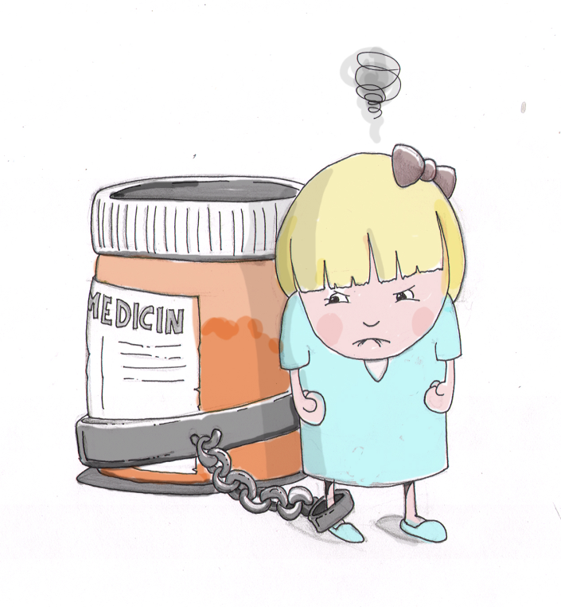
Louise, 14
Louise is 14 years old and suffers from asthma. She is treated with low dose ICS and short-acting B₂ agonist but her asthma is only partly controlled. The next step in treatment is either
  Adding long-acting B₂-agonist
  Increasing inhaled ICS
How will you inform her and her parents and assess her competence to consent?
Fish bowl

Slide 47
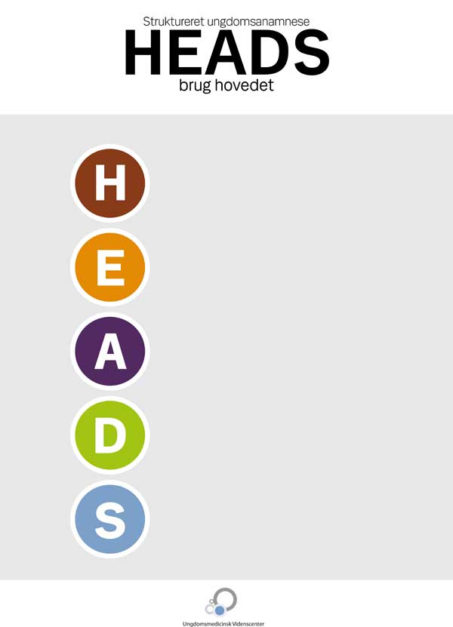
Assessing competence I
STEP approach:
Sexual maturation
Thinking (concrete/abstract)
Education/employment
Peers & parents
Home
Education
Eating
Activities
Drugs
Sexuality
Safety
Suicide
Goldenring et al, Contemporary Pediatrics 2004;21:64-90

Slide 48

Assessing competence II
Deliver information and check
Discuss options and check
Negotiate a decision

Slide 49
Deliver information and check
Deliver the information in such a way as to make sure that the adolescent fully understands what the issues are

Slide 50
Discuss the options and check
Discuss the various options with the young person and explore with him/her the medical and non-medical consequences of these options.
Discuss the advantages and disadvantages linked to each option.
Check out that the young person fully understands the issues by asking him to rephrase the information which has been presented.

Slide 51
Check understanding
What is the illness and its effects?
What treatments/investigations are necessary and why?
When does this need to be done?
What does the treatment mean to me, how will it affect my life?
What happens if I do not get the treatment?
Alternatives and their effects?
Practical consequenses for me (incl. school and friends) and family?

Slide 52
Negotiating a decision
Depending on the result of your assessment of the young person’s competence, you negotiate a final decision:
If he/she is judged competent then the decision depends on him/her
If he/she is not judged competent then the decision depends on the parents
In most cases the decision will be negotiated between the three of you

Slide 53
Case-Based Reasoning (Casuistry)
The answer is never purely medical, or legal, or social
There is never one single solution
Principle-based approaches problematic
  No clear hierarchy of principles
  Conflict of principles (autonomy vs. beneficence)
Context important
  “The devil is in the details”
  Contextual influences, relationships
All stakeholders should, if possible, have their voices heard in the proces
Young people themselves should have a voice in the proces

