Slide 1
SUBSTANCE
USE AND SUBSTANCE USE
DISORDERS
Updated July 2016

Slide 2
Objectives
Define the terminologies of adolescent Alcohol, Tobacco, and Other Drug (ATOD) use; access to and utilize the related epidemiological data
Understand the value of substance use from an adolescent’s viewpoint, and describe the range of consequences of ATOD misuse
Communicate effectively with an adolescent about substance use and implement an appropriate intervention plan as needed
Define the health professionals’ role in preventing adolescent substance misuse at the individual and community levels

Slide 3
Epidemiology

Slide 4
Tobacco Use

Slide 6
Alcohol Use

Slide 7
Alcohol Use

Slide 8
Trends in cigarette smoking (15 y.)
Hublet & al, 2006

Slide 9
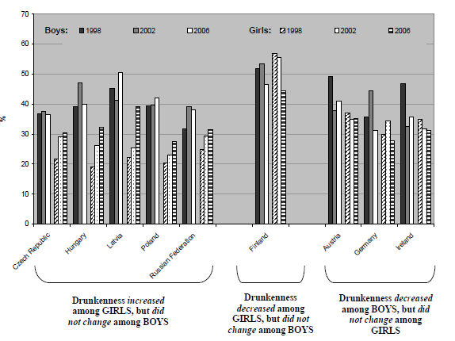
Trends in drunkeness (15 y.)
Simons-Mortin & al, 2009

Slide 10
Cannabis use in different countries (15 y.)
Godeau & al, 2007

Slide 11
Cannabis Use

Slide 13
THE GATEWAY THEORY.. STILL VALID ?
STAGE 1
STAGE 2
STAGE 3
STAGE 4
Licit drugs
Illicit drugs
82%
HARD LIQUORS
27%
82%
NO USE
BEER
WINE
COCAIN
HEROIN
CANNABIS
CIGARETTES
4%
2%
1%
Kandel & al. 1975
Patton GC, Coffey C, Carlin JB, Sawyer SM, Lynskey M. Reverse
gateways? Frequent cannabis use as a predictor of tobacco
initiation and nicotine dependence. Addiction. 2005 Oct;100(10):1518-25

Slide 14
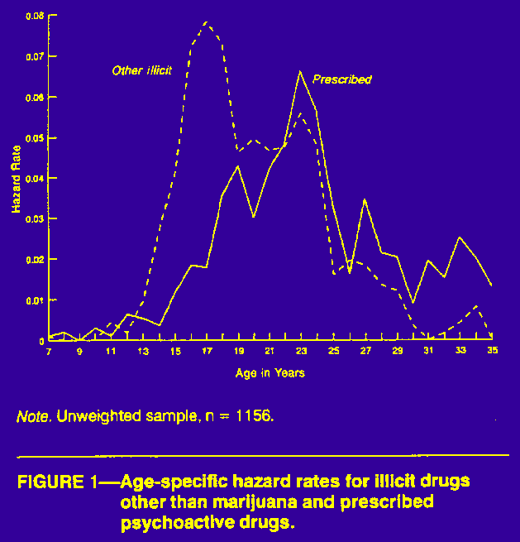
In the long term...
Kandel & al. AJPH 1995
Notes:
41
Ainsi en va-t-il pour beaucoup de jeunes de l'usage du cannabis, qui, diminue puis disparaît la plupart du temps après l'âge de 20-25 ans.
Ce phénomène est illustré par une étude menée par D. Kandel de New-York, qui a suivi pendant plus de 20 ans une cohorte d'adolescents faisant usage de drogues illégales. Comme vous le voyez, le pourcentages de jeunes consommateurs passe par un pic aux alentours de 20-25 ans puis diminue régulièrement pour atteindre des taux négligeables vers 30 ans.
La consommation de drogues prescrites, soit de médicaments elle suit une courbe paralèlle mais décalée sur la droite: il est vraisemblable qu'aux Etats-Unis comme en Suisse, les médecins soient appellés à prescrire passablement de médicaments aux jeunes ayant fait usage de drogue.. il est heureux que tout au moins, ce phénomène lui aussi tendent à disparaître avec le temps.

Slide 15
Reverse gateway theory
Frequent cannabis use as a predictor of tobacco initiation and nicotine dependence.
Patton GC, Coffey C, Carlin JB, Sawyer SM, Lynskey M. Reverse gateways?
Addiction. 2005;100(10):1518-1525.
Some Go Without a Cigarette ; Characteristics of Cannabis Users Who Have Never Smoked Tobacco
J. C. Suris, MD, PhD; Christina Akre, MA; Andre´ Berchtold, PhD; Andre´ Jeannin, MA; Pierre-Andre´ Michaud, MD
Arch Pediatr Adolesc Med. 2007;161(11):1042-1047

Slide 16
Substance use & the adolescent brain

Slide 17
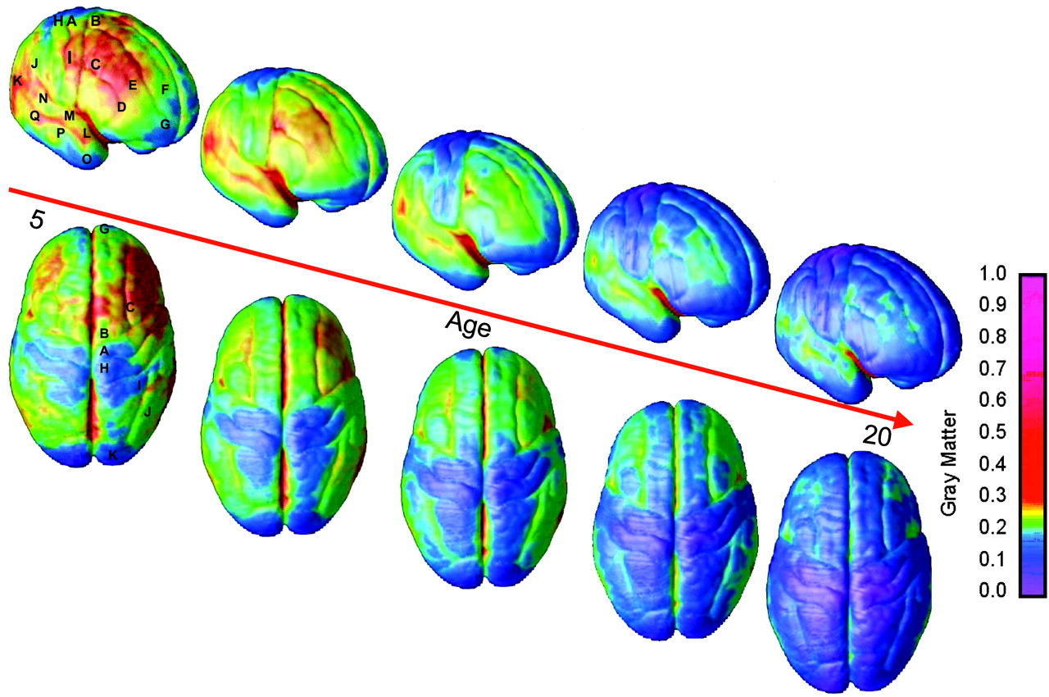
The adolescent brain
©2004 by National Academy of Sciences
Gogtay N et al. PNAS 2004;101:8174-8179
Notes:
Right lateral and top views of the dynamic sequence of GM maturation over the cortical surface. The side bar shows a color representation in units of GM volume. The initial frames depict regions of interest in the cortex as described for Fig. 1. This sequence is available in Movies 1–4 in the supporting information.

Slide 18
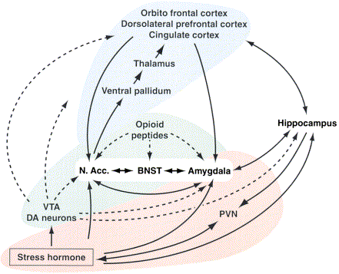
The reward system
George F Koob Ph.D and Michel Le Moal MD, Ph.D
Neuropsychopharmacology (2001)

Slide 19
Toxicity of substances for the brain
Heavy (>once daily) cannabis use and regular alcohol consumption (>20 drinks/month) have a long-term effect on brain functionning (reduction in attention and executive fontionning)
Thomas & al 2011
Regular alcohol use during adolescence leads to cognitive and behavioral dysfunction
Guerri & al, 2010

Slide 20
Definition & criteria for substance use disorders

Slide 21
Addiction
A primary, chronic disease of brain reward, motivation, memory and related circuits.
Dysfunction leads to various manifestations such as
  individual pursuing reward and/or relief by substance use and other behaviors.
  impairment in control, craving, inability to consistently abstain
  diminished recognition of behavioral and interpersonal problems.
Like other chronic diseases, addiction can involve cycles of relapse and remission.
Not many adolescents meet the diagnostic criteria for addiction (behavior and situations often transitory)
American Society for Addiction Medicine, 2011

Slide 22
Substance use disorders (DSM V)
“the dividing line between abuse and dependence was not clear; substance dependence was often confused with physical dependence; and the term abuse has pejorative connotations.. The DSM-5 replaces these with a single term: substance use disorder” (SUD)
DSM V, 2013

Slide 23
DSM V CRITERIA FOR
Substance Use Disorders
Four main areas
Impaired control
Social impairment
Risky Use
Pharmacological indicators: tolerance and withdrawal

Slide 24
Impaired control
Using for longer periods of time than intended, or using larger amounts than intended;
Wanting to reduce use, yet being unsuccessful doing so;
Spending excessive time getting/using/recovering from the drug use;
Cravings that are so intense it is difficult to think about anything else.

Slide 25
Social impairment
5. People may continue to use despite problems with work, school or family/social obligations eg repeated work absences, poor school performance, neglect of children, or failure to meet household responsibilities.
6. “Addiction” may be indicated when someone continues substance use despite having interpersonal problems because of the substance use eg arguments with family members about the substance use; or, losing important friendships because of continued use.
7. Important and meaningful social and recreational activities may be given up or reduced because of substance use. A person may spend less time with their family, or they may stop playing golf with their friends

Slide 26
Risky Use
8. when someone repeatedly uses substances in physically dangerous situations. eg using alcohol or other drugs while operating machinery or driving a car.
9. some people continue to use addictive substances even though they are aware it is causing or worsening physical and psychological problems eg the person who continues to smoke cigarettes despite having a respiratory disorder such as asthma or COPD.

Slide 27
Pharmacological indicators: tolerance and withdrawal
tolerance occurs when people need to increase the amount of a substance to achieve the same desired effect, as a desire to avoid withdrawal symptoms or to get high. People vary in their sensitivities to different substances. Specific drugs vary in terms of how quickly tolerance develops and the dose needed for tolerance to develop
Withdrawal is the body's response to the abrupt cessation of a drug, once the body has developed a tolerance to it. The resulting cluster of (very unpleasant and sometimes fatal) symptoms is specific to each drug. Withdrawal does not necessarily require medical assistance. However, withdrawal from some drugs can be fatal.

Slide 28
Substance Use Disorders SUD
Use of criteria
1-2 criteria met: mild SUD
3-5 criteria met: moderate SUD
>5 criteria met: severe SUD

Slide 29
Potential consequences of substance use disorder
Anesthesia
No symbolic thoughts
Lack of communication
School dropout & marginalization
Violence and debts

Slide 30
Assessment

Slide 31
Warning signs
Non specific
  Drop in school results
  Isolation
  Violence
  Physical symptoms
  Thefts

Slide 32
Evaluation
Frequency, quantity, circumstances
Comorbidity
  Psychosocial functionning
  Psychiatric symptoms
Environment
  Family support
  School environnement
  Peer group

Slide 33
Explore risk & protective factors
PROTECTION
  Family connectedness
  School results
  Religiosity
  No substance use by peers
  Pro social activities
  Long-term perspectives
  Mother’s education
VULNERABILITY
  Family substance use
  School problems/ADHD
  Depression
  Antisocial behavior
  Impulsivity, aggressivity
  Psychiatr. Probl (OCD)
  Age of first use
  Peer groups

Slide 34
Useful tools and interviewing skills
HEADSSS
What is the problem? Who thinks there is a problem?
Use of motivational interviewing, involve family if possible
Questionnaires
Notes:
pros
provide the adolescent with an overview of content
help younger professionals to deal with intimate matters
encourage adolescents to reflect on their lifestyles
cons
raise issues that the adolescent did not expect to discuss
raise issues that are not easy to solve
may lengthen the encounter

Slide 35
The use of screening tools
Promotes a shared vision of what the problems are (patient’s participation)
Health professionals being not very precise when evaluating substance use during interviews, allows for a non judgemental assessment of patterns of substance use
Allows the adolescent to visualize his situation as compared with young people of same age

Slide 36
CRAFFT
Scoring: 2 or more positive items indicate the need for further assessment
Have you ever ridden in a Car driven by someone (including yourself) who was high or had been using alcohol or drugs?
Do you ever use alcohol or drugs to Relax, feel better about yourself, or fit in?
Do you ever use alcohol or drugs while you are by yourself Alone?
Do you ever forget things you did while using alcohol or drugs?
Do your Family or Friends ever tell you that you shouldcut down on your drinking or drug use?
Have you ever gotten into Trouble while you were using alcohol or drugs?
Knight Archives of Pediatrics & Adolescent156(6) 607-614, 2002.27

Slide 37
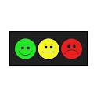
DEP-ADO & OTHER TOOLS
http://www.risqtoxico.ca/documents/DEP-ADO_ang_V3_2.pdfMisusehttp://www.risqtoxico.ca/documents/DEP-ADO_ang_V3_2.pdf
Effectiveness
Multiple substances listed
Quantity
Age of beginning of regular use
Lifetime use and 30 past days use
Alcohol Binge drinking
Psychosocial consequences
Tobacco
http://www.douglas.qc.ca/uploads/File/Formation-croisee-2011/screening-substance.pdf
Easy Scoring
Notes:
Demander comment définir misuse

Slide 38
INTERVENTIONS
Motivational
interviewing
Risk reduction
Brief interventions
Improve environment
Psychotherapy
Misuse
Abuse and
dependence

Slide 39
> 7 days abstinence rate
Biochemically confirmed abstinence rates for the total sample were 9% in MI versus 2% in Brief Advice BA (2005)

Slide 40
ADI = adolescent drinking index; SC = standard care
(2004)

Slide 41
Treatment of severe substance misuse or abuse
Working with the family (e.g. multidimensional family therapy MDFT)
Working within a network (e.g. with the school)
Cognitive-behavioral therapy
(Medication / drug testing)
Toumbourou, Lancet, 2007

Slide 42
Multi dimensional family therapy
Ambulatory.
Developmental perspective
Centered on addiction
Intensive and of short duration (6 months)
Enactment-based
Focusing on 1) the adolescent; 2) the parents; 3) the family; 4) the extra-family context
Organized in three steps
  Evaluation and creation of alliance
  Focus on actions & solutions
  Consolidation
Dr Howard Liddle et al.
CTRADA, Université Miami

Slide 43
REFERRAL PROCESS
The answers
A detailed assessment with a mental health professional doesn’t imply a long treatment
Accompany the adolescent to the specialist
or let him be accompanied by a friend
Organize a co-consultation
Remain in the situation, follow-up to be sure that the process continues

Slide 44
Prevention

Slide 45
Prevention: principles
Information: not enough
Life skills (in schools)
Environmental measures
Policies
Room, 2012

Slide 46
PREVENTION IN THE FIELD OF SUBSTANCE USE/MISUSE/ABUSE
Information: not effective
Life skills (in schools)
Environmental measures
Policies
Tobler al, J Prim Prevention, 2000
Kumpfer, Subst Use & Misuse, 2003
Botvin, Addict Behav, 2000

Slide 47
Programs based on peer-led activities, those addressing skills and those involving the parents & families seem to be more effective than those based on more traditional ways. Preventive methods should start at age 12 years and continue to age 18 years.
School programmes based on a combination of social competence and social influence approaches showed, on average, small but consistent protective effects in preventing drug use
Tobler, NIDA Res Monogr. 1994
Foxcroft, Cochrane, 2011
Faggiano, Cochrane 2014
Flynn AB, Falco M, Hocini S, JAMA, 2015
Notes:
In the area of the prevention of legal and illegal substance use and misuse, programs based on peer-led activities, those addressing skills and those involving the parents & families seem to be more effective than those based on more traditional ways.

