Slide 1
Youth Friendly Health Care
Module C5
Updated july 2017

Slide 2
So far we have learned …...
The importance of taking developmental aspects into account
The necessity of relying on quality epidemiological data

Slide 3
By the end of this afternoon the participants will be able to...
Describe the characteristics of major components of youth friendly health care
Analyze main barriers and facilitating factors when developing services for adolescents
Design a basic plan for a new YFHS in a chosen setting and be prepared to advocate for it
Discuss how to monitor and evaluate YFHS
Notes:
Identify target audiences to which deliver training in adolescent health is one facilitating factor to develop YFHS
Réfléchir pour chaque objectif les messages clés puis choisir la méthode pédagogique pour faire émerger les messages clés

Slide 4
Why do we need youth friendly health care?
Burden of disease
Mortality/morbidity over the last decades
Young people have specific needs

Slide 5
YFHS vs YFHC

Slide 6

WHO standards for Youth Friendly Health Services (YFHS)
Accessible
Acceptable
Appropriate
Effective
Equitable
Who 2002

Slide 7
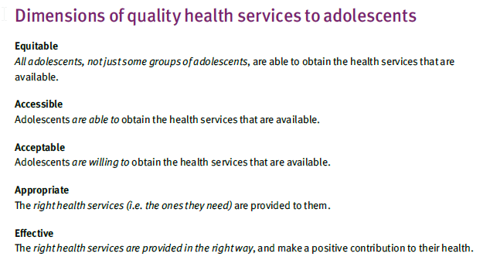

Slide 8

WHO STANDARDS
FOR ADOLESCENT FRIENDLY CARE
Adolescents’ health literacy
Community support
Appropriate package of services
Providers’ competencies
Facility characteristics
Equity and nondiscrimination
Data and quality improvement
Adolescents’ participation
Nair & al. JAH, 2015
Notes:
Faire la distinction entre YFHS YFHC

Slide 9
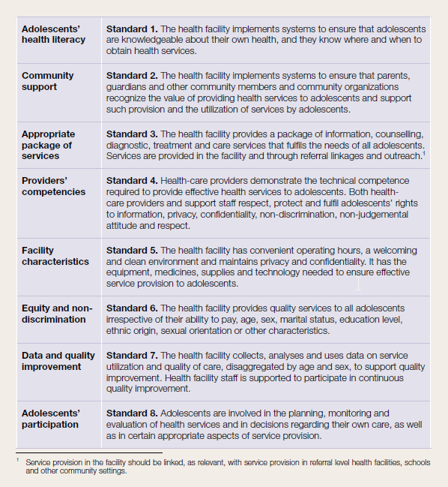

Slide 10
Settings
Hospital
School health services
Primary health care services
Social facilities

Slide 11
Four levels of action
Youth friendly policies
Youth friendly procedures
A youth friendly environment
A youth friendly staff
Notes:
Utiliser post-it avec 4 domaines

Slide 12
Exercise 1: 30 min group work
4 areas of concern sticked on the wall
Group work for 20 minutes
Use post-it and stick under the right colomn

Slide 13
Youth Friendly Policies
Fulfill the rights of adolescents for all adolescents
Take into account the different needs of the population
Pay special attention to gender factors
Guarantee privacy and confidentiality
Free or not expensive and flexible about payment

Slide 14
Youth Friendly Procedures
Easy access, registration/retrieval procedure (anonymity if required)
Short waiting time
Drops-ins’ without prior appointment possible
Strong linkages to other health and social service providers

Slide 15
Youth Friendly Environment
Provide a safe environment
Convenient location with appealing ambiance
Convenient working hours
Offer privacy and avoid stigma
Provide information and education material

Slide 16
Youth Friendly Staff
Technically competent, interested and concerned
Have interpersonal and communication skills
Are motivated and supported
Are non-judgmental and considered
Devote adequate time to patients
Treat all patients with equal care and respect
Provide information and support
Experienced in group work
Can be contacted at repeat visits (continuity of providers)
Culturally sensitive

Slide 17
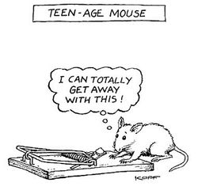
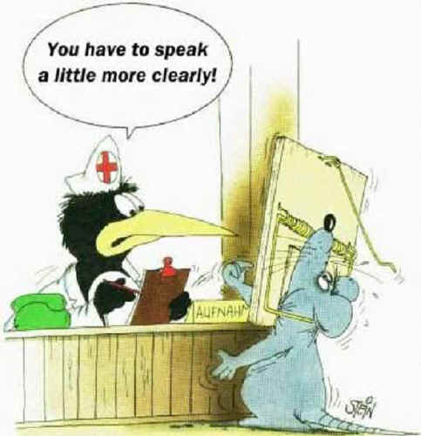
Barriers and facilitators

Slide 18
Exercise 2: divide the participants in two groups 1) work on adolescent vignette et 2) on health professionnal vignette
Adolescent vignette (group 1): you are a 16 y.o boy/girl and you have had your first sexual experience. You did not protect yourself as this experience was unplanned. Your parents do not know this yet. You are very anxious about STI +/- pregnancy. You go to the doctor. What could help you to feel at ease, what do you expect from him/her?
Health care professionnal vignette:

Slide 19
Exercise 2: divide the participants in two groups 1) work on adolescent vignette et 2) on health professionnal vignette
Health care professional vignette (group 2): you are a health professional (GP/nurse…) working in a private practice. Your secretary tells you that you are going to see a new patient, adolescent (16 y.o) who had unprotected sex and who does not want you to tell his/her parent. How do you feel? What could help you with managing this teenager? What are your worries?

Slide 20

Young people
Do not want to be helped and want to find their ways and solutions on their own
Do not consult easily
Do not trust health care providers easily

Slide 21

Health professionals
feel unconfortable when faced to young people (or their parents)
feel they lack training
have time and financial constraints that interfere
do not always grasp the core concepts of adolescent health as a speciality

Slide 22
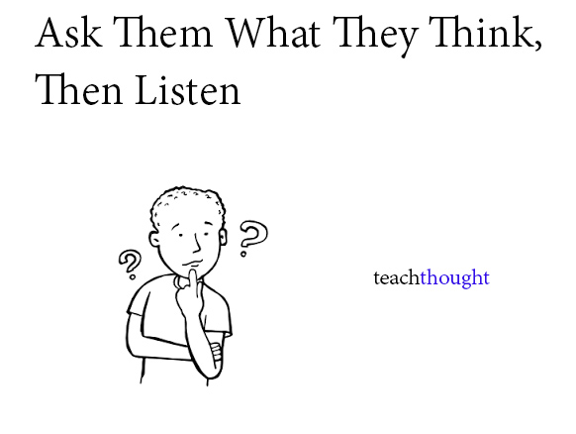
Asking Young people

Slide 23

AFHC from YP’s perspective
Accessibility
Staff communication & technical skills
Guideline-driven care
Appropriate environment
Interdisciplinary network approach
Participation

Slide 24
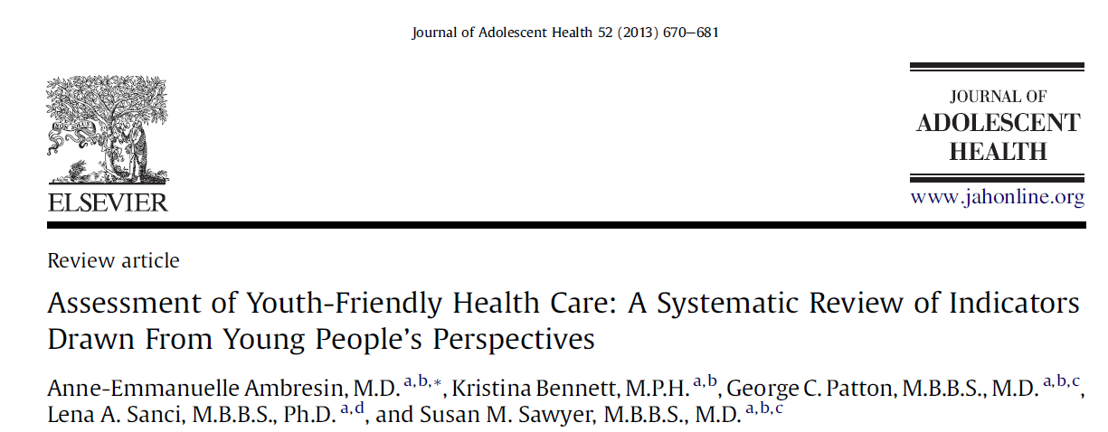

Slide 25
What do adolescents perceive
as "friendly" health services ?
Confidentiality
Short waiting time
Low cost/free service
'One stop shop'
Clinic is close to home, school or work
Friendly staff
Convenient opening hours
Staff is not rushed

Slide 26
Exercise 3: Group work and fish bowl
After returning to your country from the EuTEACH summer school, you have been offered to open a teen clinic. The clinic is in an old (but nicely renewed) building belonging to the regional health department (so no rent to be paid). The building has 6 rooms, a small kitchen and a bathroom.
You can organize it as you wish (after all, you are the expert!) and you have a budget of 500’000 (that includes your own salary). Knowing that the salaries (working full time) for possible team members are as follows:
Notes:
Fish bowl pour la restitution par groupe

Slide 27
WHO would you hire and WHY?
Senior physician: 150’000
Senior psychologist: 130’000
Medical resident: 120’000
Family planning counselor: 100’00
Dietitian: 100’000
Nurse: 100’000
Secretary/receptionist: 90’000
Social worker 100’000…

Slide 28
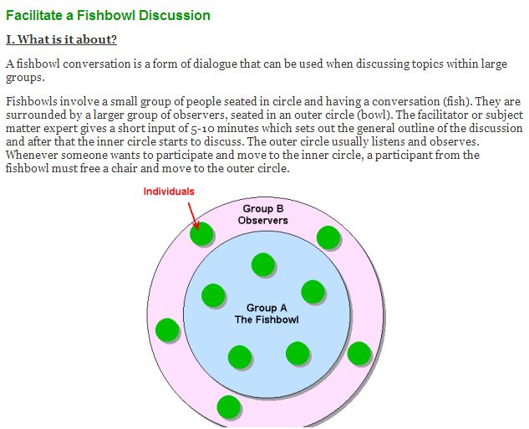

Slide 29
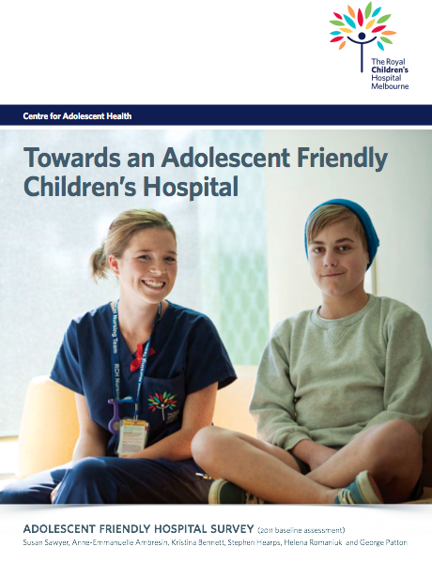
How to monitor and evaluate YFHS/C?
Consumer participation
eg Youth Advisory Committee
Clinical guidelines
eg psychosocial assessment
IT access & support
eg social networking
Academic leadership
eg Clinical, teaching, research
Support services
eg education, peer support
Physical environment
eg branding, adolescent ward
Hospital policy
eg upper age, transition

Slide 30
Notes:
Taking into account the objectives of your YFHS, define and list process indicators as well as output and outcome indicators. Discuss the usefulness and limitations of these indicators.
Examples:
Process indicator (the way services are organized and delivered) number of facilities opened, number of services offered, user satisfaction
Output indicator (immediate and concrete results of services): number of consultations, profile of users, change in user knowledge and practice
Outcome indicator: (the effect of the service on the health status of the target population): reduction of teenage suicides, STIs or pregnancies.

Slide 31
Percents of adolescents who have been screened in different areas of HEADS
Sawyer & al, Melbourne, 2012

Slide 32
Change through an ecosystem
Policies
Schools
Community
Health care providers
Procedures
Environment

