Slide 1
Social Determinants of adolescent health
Updated July 2016

Slide 2

WHO Commission on the Social Determinants of Health, 2008
(SDH)

Slide 3
Executive summary
“Our children have dramatically different life chances depending on where they were born…
And within countries, the differences in life chances are dramatic and are seen worldwide. The poorest of the poor have high levels of illness and premature mortality….
In countries at all levels of income, health and illness follow a social gradient: the lower the socioeconomic position, the poorer the health.
It does not have to be this way and it is not right that it should be like this.”

Slide 4
  understanding and enhancing health requires a focus “upstream” away from an individual’s risk or protective factors to the social patterns and structures that shape people's chances to be healthy

Slide 5
  “the conditions in which people are born, grow, live, work and age”
  shaped by the distribution of money, power and resources at global, national and local levels
  influenced by policy choices at each of these levels

Slide 6
SOCIAL DETERMINANTS
  Nations present young people with structures of opportunity as they grow up
Structural determinants
  generate social stratification, such as national economic, political and social welfare systems and education systems.
Intermediate determinants
  flow from the configuration of underlying social stratification
  determine differences in exposure and vulnerability to health compromising conditions.
  family environment, availability of food, recreation and education

Slide 7
Life-course effects of SDH
(after Hertzman….)
Latent
  biological or developmental early life experiences which influence adult health independent of intervening experience
Pathway
  experiences that set individuals onto life trajectories that influence health, well-being, and competence over the life course
Cumulative
  accumulation of advantage or disadvantage due to exposure to unfavourable environments over time)

Slide 8
Adolescent development: unique opportunities for social determinants to influence health
Central Nervous System (CNS) and pubertal development, driving identity formation
adoption of behaviours (e.g. smoking, drug use, sex)
life stage transitions and changes in personal and social responsibilities and relationships entailed. World Bank:
  learning: transition from primary to secondary to higher education
  work: transition from education into workforce
  health: transition to responsibility for own health
  family: i.e. transition from family living to autonomy, early marriage and parenthood.
  citizenship: transition to responsible citizenship

Slide 9
Transition to experience of unequal chances related to gender, ethnicity, education, employment and socioeconomic status
These transitions may represent critical points for preventing the accumulation of health risk...

Slide 10
Adolescence may be a second critical period for SDH
cumulative effects of early childhood development
  modified by new latent and pathway effects in adolescence
new latent effects – puberty & CNS development
  Initiate transitions in family, peer and educational domains
new pathway effects
  related to transitions
  adoption of health behaviours

Slide 11
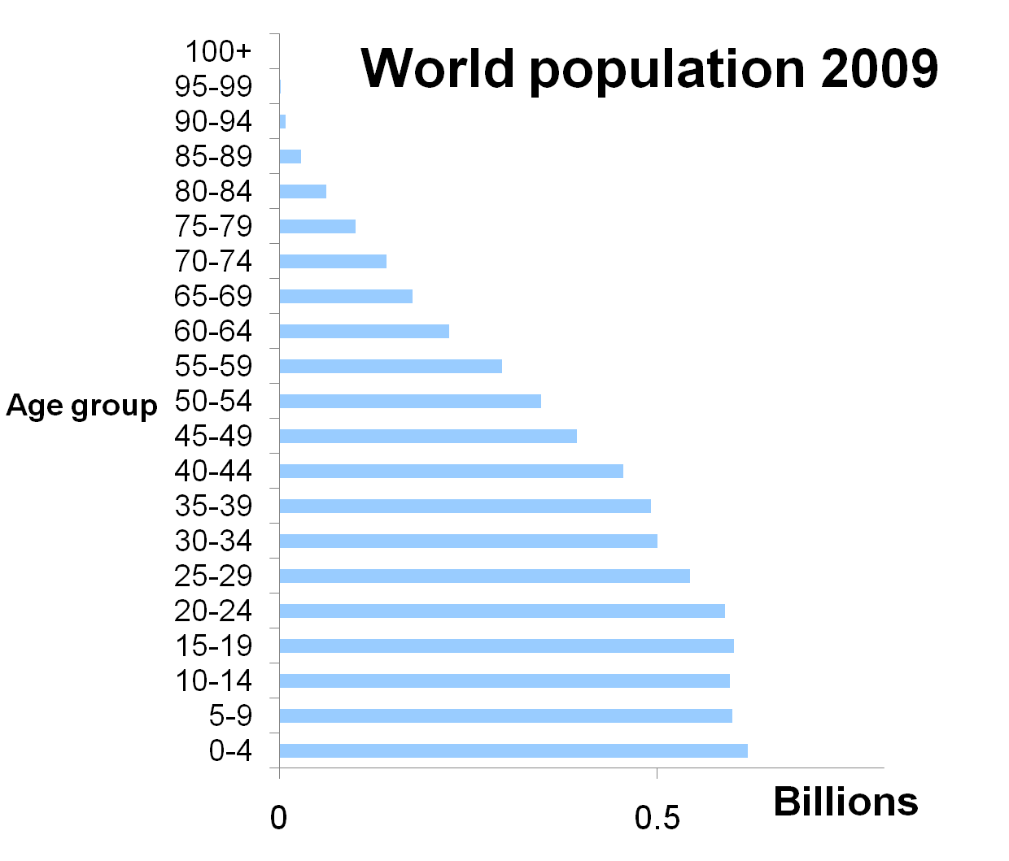
10-20 years = 17.7%

Slide 13
Variations between countries

Slide 14
there are dramatic variations in adolescents’ health BETWEEN countries
52
PNG
Korea
2
Notes:
Our starting point is that there are dramatic variations BETWEEN countries in adolescent health
100 fold difference between South Korea (2/1000 women) and Niger 199/100,000
Note North Korea = 0.7!
50-fold difference in smoking between Maldives and Papua New Guinea

Slide 15
variations exist despite similar adolescent developmental issues
SDH approaches focus upstream
individual factors social patterns & national structures that shape people's chances to be healthy

Slide 16
Evidence for the SDH influencing adolescent health
Review of literature
  Structural SDH
  Intermediate/proximal SDH
  Effect of structural SDH on intermediate determinants, influencing exposure
  Quality of data
  LMIC data
Analyses of variations between nations
    Reflect variation within nations
    Informative re generalisability to LMIC

Slide 17
MALE MORTALITY rate
& gross domestic product
Male all-cause mortality (15-19yr) & GDP
Notes:
All-cause mortality per 100,000 and GDP per capita purchasing price parity – 2005 from WORLD BANK and WHO
GDP is in thousand US$

Slide 18
Teenage birth rate
& gross domestic product
Niger
Chad
Mali
Mozambique
Uganda
Gabon
Equatorial Guinea
Venezuela
Mexico
Panama
USA
NZ
UK
Australia
UAE
Qatar
Luxembourg
Tunisia
Notes:
Teenage pregnancy – birthrate per 1000 women 15-19yr
Note down near Tunisia is Libya and a range of Islamic countries including Malaysia

Slide 19
WEALTH AND GROSS
domestic product
Notes:
Describe
Then look in more detail at some selected areas.

Slide 20
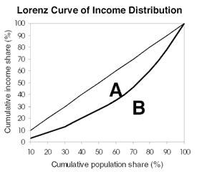
Equality line
The Gini coefficient is calculated as the area A divided by the sum of areas A and B.
0= absolute equality
1= absolute inequality

Slide 21
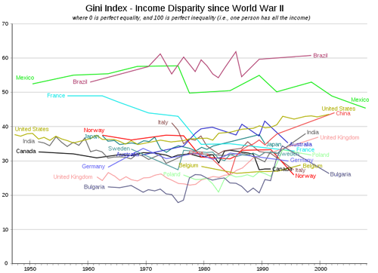

Slide 22


Access to wealth: inequality harms and kills
Each 10 increase in Gini increases teen births
by 30 per 1000
Notes:
The published paper shows that there are strong associations between nearly every outcome we measured and national wealth, with greater wealth associated with better health and wellbeing
National wealth is little amenable to direct intervention.
But access to wealth for young people is something we can do something about.
This graph shows the associations of teenage birth rate with income inequality as indicated by the Gini coefficient.
The association is large and highly significant B=0.61 p<0.0001. i.e. for every SD increase in Gini (SD=9.7) the birth rate increases by 0.61*48=approx 30.

Slide 23
Teenage birth rate and inequality
1990 1995 2000 2005 2010

Slide 24
Gini and male all-cause mortality
Notes:
Note that the Beta coefficient was slightly higher for Gini for 10 years previously compared with current (B was 0.55 compared with 0.45)

Slide 25
Bullying and inequality in females
Notes:
Psychosocial stressors extremely strongly associated with inequality
Wider spread in males – more with high bullying but quite equal countries.
I.e. Always exceptions to the rules

Slide 26
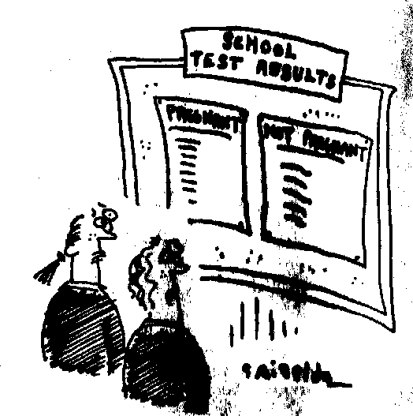
Education
School
Test Results
Pregnant
Not pregnant
Notes:
Education systems can be understood as structural determinants in that access to education generates social stratification that influences health life-long.(10) The WHO Commission on SDH emphasised the wealth of evidence linking educational involvement and attainment in early life with later health outcomes.(11) . The priority placed by the world community on early education is reflected in the 2nd Millenium Development Goal – that all children complete primary school.
However schools also function as intermediate determinants, in that connection to school and school quality influence health outcomes directly. The relationship between education and health in adolescence is complex and bi-directional, as there is evidence both that poor health may reduce educational attainments (and thus SES) and that poor educational outcomes are related to poor health in adolescence and longer-term.(21) Note that these associations are not limited to deprived groups.(21) However, inequality of opportunity in the educational sector during adolescence may exacerbate health inequalities via the influence that education exerts on lifestyle.(10)

Slide 27
Access to education: the best health intervention
Each 10% rise in education decreases deaths by
20 per 100,000
Notes:
I could have again shown you the teenage birth rate associations here – but the importance of education for the prevention of teenage pregnancy is well described. However the association goes much further than this – and in fact, the largest effect size was for overall mortality in boys!
7-fold variation in male mortality; from 36 in Singapore to 236 in Brazil and Ukraine – and missing many of the very high income countries!
Higher the % in secondary education, the lower the overall mortality rate. B=-0.41. p=0.001. i.e. each 10%

Slide 28
Education & teenage births
% females in secondary education

Slide 29
Education & HEALTH OUTCOMES

Slide 30
LITERACY & HEALTH OUTCOMES
Notes:
We found that youth literacy and secondary school completion had similar associations with health outcomes. Countries with more educated youth had lower male injury mortality and lower female communicable and NCD mortality, as well as lower HIV prevalence, teenage pregnancies, injuries and violence.
Countries with higher female literacy had higher proportions of female smokers, possibly due to peer effects/status effects etc.
The benefits of education for mortality appeared stronger for young men compared with young women.

Slide 31
Intermediate/proximal determinants
 | Smoking | Alcohol | Drugs | Risky sex | Depression | Violence
Parental connectedness | + | + | + | + | + | +
School connectedness | + | + | + | + | + | +
Peer (prosocial) connection | + | + | + | + | + | +
IOM 2010 (Hawkins)

Slide 32
SDH approaches for adolescent health

Slide 33
SDH approaches for adolescent health
Build upon existing risk and protective factor models in adolescent health
Help us identify and intervene on the “causes of the causes”
May help us understand how determinants “get under the skin”

Slide 34
Taking action on the social determinants
Action needed is different to that for children or adults
Intervene on malleable proximal determinants
Policy actions on structural determinants
1. Improve access of young people to wealth
  -youth access to employment
  -taxation policies re youth employment
  -microfinance initiatives
2. Improve access to secondary education
  -boys as well as girls

Slide 35
Taking action…
3 Improve the conditions of daily life
-gender equity; young mothers
focus on injury prevention
-transport policies, road safety
-firearm, knife, pesticide control
4 Recognise adolescence as a second critical period in the life-course in which social determinants of health act to program health life-long

Slide 36
Research questions
Lifecourse issues
Latent effects: How strong are the latent effects of puberty and CNS development
Pathway effects: Can a good adolescence put children back “on trajectory”
  And how much does a bad adolescence throw children off good trajectory
Cumulative effects: Is adolescence important?

Slide 37
STRATEGIES
measure the problem
evaluate action
expand the knowledge base
develop a workforce that is trained in the social determinants of health
raise public awareness about the social determinants of health, advocate

Slide 38
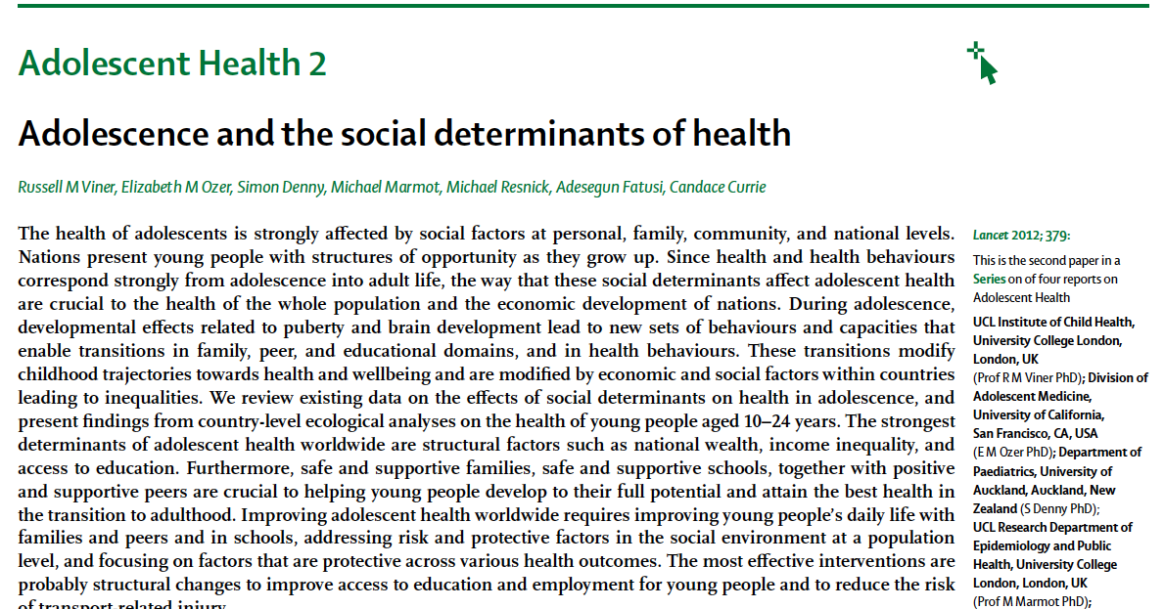

Slide 39
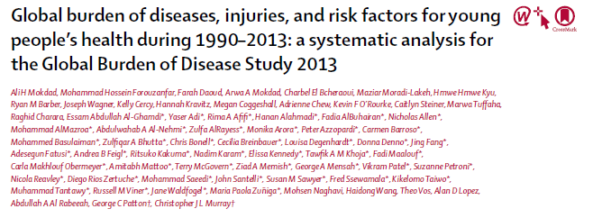
The Lancet, 2016
Lancet commission on adolescent health
and wellbeing

