Slide 1
EVIDENCE BASED PREVENTION & HEALTH PROMOTION AS APPLIED TO ADOLESCENTS
Updated 2015

Slide 2
So far we have covered...
Adolescent development and how to address some clinical situations in an effective way
How to gather and interpret relevant indicators in the field of adolescent health

Slide 3
Objectives
Identify some major areas in which prevention & health promotion strategies can be developed
Review existing evidences in the field of prevention & health promotion
Integrate the different steps involved in the design, implementation and evaluation of an intervention

Slide 4
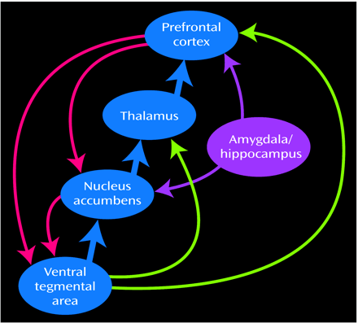
The adolescent brain
Pruning
Late development of
pre frontal cortex
Volkow 2005; Ruben & Baler, 2006;
Goldstein & al, 2002-2007; Giedd, 2008

Slide 5
Ethical statement.. he best way to improve the health of adolescent is to create safe environments

Slide 6
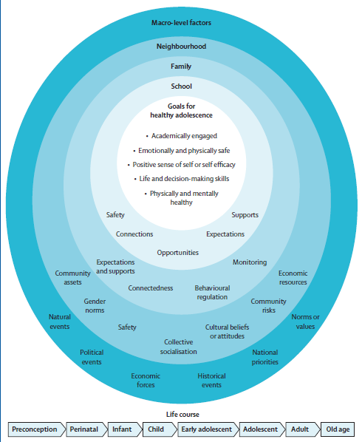
A framework for interventions
Social/structural determinants
  Geography
  Culture
  National wellfare
  Gini index/equity
  Ethnic groups
  Gender issues…..
Proximal determinants
  Family structure/function.
  Peer relationship
  School/work envirnmt.
Bronfrenbrenner, ~1970
Viner, Lancet series, 2012,

Slide 7
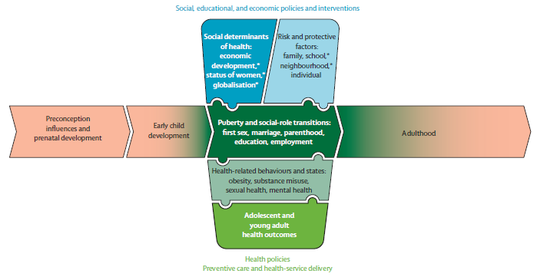
A lifespan perspective
Social determinants
Risk & protective
factors
Behaviours
Outcomes
Lancet series, 2012, Blum/Patton/Viner

Slide 8
Identify the major areas in which prevention & health promotion should be developed

Slide 9
SHORT GROUP DISCUSSION
What would be the most important issues in your country/region?

Slide 10
Global burden of disease:
DALY
Disability Adjusted Life Years
The sum of years of potential life lost due to premature
mortality and the years of productive life lost due to disability.
Ezzati & al, 2002

Slide 11
Global burden of disease
Adolescence
WHO, 2000
WHO, 2005

Slide 12
Main areas of concern differ from one region of the world to another
Injuries and violence
Substance use & misuse
Mental health, depression, suicide
Sexual & reproductive health
Malnutrition, overweight/obesity
Chronic conditions

Slide 13
MDGs:
Millenium Development Goals
The eight Millennium Development Goals (MDGs) form a blueprint agreed to by all the world’s countries and
all the world’s leading development institutions.
They have galvanized unprecedented efforts to
meet the needs of the
world’s poorest
Eradicate extreme poverty and hunger
Achieve universal primary education
3) Promote gender equality and empower
women
4) Reduce child mortality
5) Improve maternal health
6) Combat HIV/AIDS, malaria and
other diseases
7) Ensure environmental sustainability
8) Develop a global partnership for
development
United Nations, 1999

Slide 14
Evidences in the field of prevention & health promotion

Slide 15
SHORT GROUP DISCUSSION
What do we mean by evidence ?

Slide 16
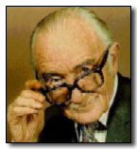
What do we mean by evidence ?
Strength of the evidence
Size of effect
Relevance of the evidence
Levels I & II
randomised controlled trial
Level III.
non-randomised studies of groups of people with a control group
Level IV.
non-randomised studies of groups compared with previous or historical information
Level V.
Evidence is from single case studies
Levels I & II
randomised controlled trial
Level III.
non-randomised studies of groups of people
with a control group
Level IV.
non-randomised studies of groups compared
with previous or historical information
Level V.
Evidence from single case studies
www.cochrane.org/reviews.

Slide 17
A framework
 | Health Sector | Education Sector | Media | And many others: labour, criminal-justice, social services, parents, peers, etc.)
Information and Life Skills
Services and Counselling
Safe and Supportive Environment
Opportunities to participate
WHO, CAH, 2003

Slide 18
A framework
 | Health Sector | Education Sector | Media | And many others: labour, criminal-justice, social services, parents, peers, etc.)
Information and Life Skills
Services and Counselling
Safe and Supportive Environment
Opportunities to participate
Y F H S
Y F H S
CAH/WHO, 2003
Notes:
Let us first discuss the issue of the delivery of health care as a public health strategy targeting specifically young people

Slide 19
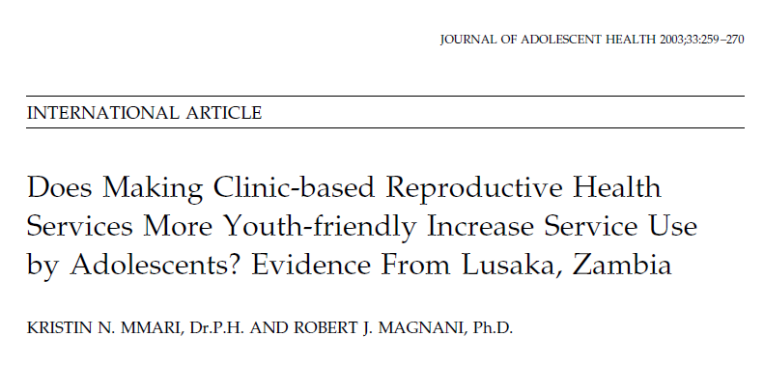
Although the projects appear to have improved the clinic experience for adolescent clients and to have increased service use levels at some clinics, the findings suggest that community acceptance of reproductive health services for youth may have a larger impact on the health-seeking behaviors of adolescents.

Slide 20

The findings of the data collected to date show that the clinics can implement the standards regardless of size and location. The clinic environment is cleaner, privacy is maintained, and infection prevention measures are carried out more consistently. The clinic staff have been transformed into a team that takes responsibility for the quality of care. They have the skills to solve problems and take action, and staff attitudes in many clinics have changed dramatically towards youth

Slide 21
Does prevention within the health care setting work ?
(e.g. using headsss)

Slide 22
> 7 days abstinence rate
Biochemically confirmed abstinence rates for the total sample were 9% in MI versus 2% in BA

Slide 23
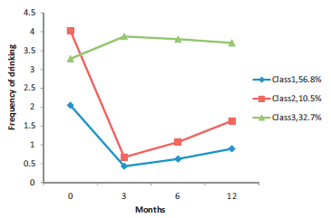
J Pediatr. 2004
Trajectories in
drinking behavior
Drug & alc dep 2012

Slide 24
A framework
 | Health Sector | Education Sector | Media | And many others: labour, criminal-justice, social services, parents, peers, etc.)
Information and Life Skills
Services and Counselling
Safe and Supportive Environment
Opportunities to participate
SCHOOL
HEALTH
CAH/WHO, 2003
Notes:
Let us broaden the scope of our review and turn to the role of the school system. As pupils represent a captive audience and as most adolescents stay at school until the age of 16 or later, many preventive programs have been developed which are implemented within the schools.
A fairly large body of literature has focused on the effectiveness of school interventions.

Slide 25
Types of interventions
Areas for interventions
  Focused (tobaco, sexuality, etc)
  Non focused (quality of life)
Pedagogic approach
  Information/education
  Life skills
  Link with the community
  Global approach (healthy schools)
Duration
  “one spot” intervention
  Program covering a term or several years
Notes:
One has to distinguish those programs which focus explicitly on a specific subject, such as for instance the use of substance or safe sex and those which favour a more global approach to tackling health promotion.
Also, while many interventions tend to be unidirectional and narrow-focused, more and more countries and regions have come to adopt life-skills approaches stressing the competences that young people can develop to make better choices, to deal with conflicts or to engage in meaningful relationship with their peers and with adults.
Obviously, the duration of the intervention does impact on the results, and the more consistent the messages are over time, the greater the magnitude of the expected changes.
What does the literature say about interventions targeting specific areas ?

Slide 26
Cumulative impact of interventions in the school setting
Specific knowledge
Non specific knowledge
.80
Size effects
Behaviour
.50
attitudes
.25
Nb. hours
10
20
40
60
80
WHO, 1990

Slide 27
Specific programs: substance use
School programmes based on a combination of social competence and social influence approaches showed, on average, small but consistent protective effects in preventing drug use
Faggiano & al Cochrane 2013

Slide 28
In the field of sexual behaviour, various evaluations have shown that sexual education does not increase the rate of adolescents becoming sexually active at any age and may even decrease it; Moreover, most of the studies do show a positive impact in the field of contraception and protection against STI’s
Specific programs: sexual education
Kirby Adolesc Health. 2007
Kirby & al, 2007, Oakley & al, BMJ 1995
Notes:
In the field of sexual behaviour, various evaluations have clearly shown that sexual education does not increase the rate of adolescents becoming sexually active at any age and may even decrease it; Moreover, most of the studies do show a positive impact in the field of contraception and protection against STI’s

Slide 29
Specific programs: sexual education
Combination of educational and contraceptive interventions appears to reduce unintended pregnancy among adolescents.
Oringanje & al, Cochrane, 2008
Comprehensive Sex Education Is Effective, Does Not Promote Sexual Risks
McKeon, Advocate for youth, 2006
Schoolwide changes in condomuse demonstrated that aschool-based program can reduce the sexual risk behavior of adolescents
Basen-Engquist & Kirby, 2001

Slide 30
The European Network of Health Promoting Schools
Member countries
Albania
Austria
Belgium/Fl.
Belgium/Fr.
Bulgaria
Croatia
Cyprus
Czech Rep.
Denmark
Estonia
Finland
France
Germany
Greece
Hungary
Iceland
Ireland
Israel
Italy
Kazakhstan
Latvia
Lithuania
Luxembourg
Malta
Moldova
Netherlands
Norway
Poland
Portugal
Romania
Russian Fed.
Slovak Rep.
Slovenia
Spain
Sweden
Switzerland
TFY Rep. of Macedonia
Turkey
Ukraine
United Kingdom

Slide 31
Health promoting schools
Provide healthy environment
Promote individual, family and
community responsibility for health
Encourage healthy lifestyles in equipping
pupils with knowledge and skills
Plan a coherent health education curriculum
Exploit the availability of community resources
Notes:
Although the range and comprehensiveness of services varies greatly from one school to another, most of the school who accept to enter the network are committed to:
Provide healthy environment
Promote individual, family and
community responsibility for health
Encourage healthy lifestyles in equipping
pupils with knowledge and skills
Plan a coherent health education curriculum
Exploit the availability of community resources
To what extent does this global approach impact on health?
There are not many well designed studies which have attempted at measuring such results. One extremely interesting exception to this, although it comes not from Europe but from Australia, is the Gatehouse project.

Slide 32
The school ethos and environment..
The WHO Health Promoting School framework for improving the health and
well-being of students and their academic achievement (Langford & al, Cochrane, 2014)
The results of this review provide evidence for the effectiveness of some interventions based on the HPS framework for improving certain health outcomes but not others:
body mass index (BMI),
physical activity,
physical fitness,
fruit and vegetable intake,
tobacco use, a
being bullied
Health Evidence Network

Slide 33
The Gatehouse project
“Improving school ethos may reduce substance misuse and teenage pregnancy”
Improved learning
outcomes
Health & Emotional
well-being
INDIVIDUAL CHARACTERISTICS
Sense of belonging
Connectedness
Security
Communication
Positive regard/
Participation
Skills
Opportunities
SOCIAL AND LEARNING ENVIRONMENTS
Patton & al.
Notes:
This program has been developed in a set of pilot schools, including several strategies such as small group life-skill interventions, implementation of explicit rules, and has stressed the quality of pupil-teacher bonding. It must be stressed that this was a very participatory process involving the pupils, their parents and the staff, clearly along the line of the Ottawa chart.
What is mostly interesting is that, when compared with those similar school which had the program, the pupils from the pilot schools exhibit a lower rate of substance use, as exemplified in the next slide.

Slide 34
The Gatehouse project:
impact on substance use
%
Analyses adjusted for baseline school substance use
Patton & al, 2004
Notes:
The influence of the school climate and the quality of pedagogy on the health of the pupils has also been shown in other contexts and countries, including, among others Germany, France and Switzerland.
The lesson of these approaches is that one effective way, even maybe the most effective way to improve the health of adolescents is to work on their environment.

Slide 35
A framework
 | Health Sector | Education Sector | Media | And many others: labour, criminal-justice, social services, parents, peers, etc.)
Information and Life Skills
Services and Counselling
Safe and Supportive Environment
Opportunities to participate
Environment,
policies
& advocacy
CAH/WHO, 2003
Notes:
The main theme of our congress is Politics, Policies
and /or the Public's Health
Indeed, we may effectively reduce the burden of diseases of all young people and improve their quality of life in adopting large scale strategies involving several settings and types of message, this will be the last part of my talk.

Slide 36
Effectiveness of interventions
In the field of injury prevention, interventions that have been shown to be effective include compulsory cycle helmet use, areawide traffic calming methods, child-safety restraints, child-resistant containers and window bars to prevent falls. Legislation generally has been found to be most effective means of implementing these, but environmental modification also play a part. In the field of injury prevention, all reviews show the superior environmental of legislative measure over behavioral intervention
Health Evidence Network, WHO, 2005
Toroyan &al.Youth and road safety, WHO, 2007
Rivara, Injury Prevention, 2002
Policy briefing: Adolescents - injury risks and prevention evidence Eurosafe, 2011

Slide 37
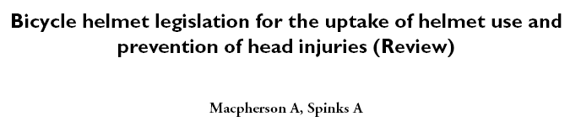
Bicycle helmet legislation appears to be effective in increasing helmet use and decreasing head injury rates in the populations for which it is implemented.
Macpherson & Spinks, 2008
Kanny & al. 2001

Slide 38
Policies …
in the field of obesity:
http://ec.europa.eu/dgs/health_consumer/consumervoice/cvsp_42005_en.pdf
Notes:
The International Obesity Task Force (IOTF) is part of the International Association for the Study of Obesity. It alerts governments to the growing health crisis threatened by soaring levels of obesity. It has recently initiated a platform which brings together EU- level representatives of the food industry, advertisers, retailers, fast-food restaurants, the cooperative movement, the consumer movement and health NGOs in order to galvanize EU- wide action against obesity
.

Slide 39
Policies …
in the field of obesity:
Notes:
The next slide provides you with some examples of what is currently done in several European country on a policy level:
Sweden does not permit advertising aimed at children under 12.
Ireland has introduced a „Children‘s Advertising Code“ applying health warning messages to the advertising of fast food, confectionery and soft drinks.
The Flemish region of Belgium does not permit advertising five minutes before or after programmes aimed at children aged under 12.
In the Netherlands, public broad-casters are not allowed to interrupt programmes that are aimed at children under 12 with advertisements, etc.
I mentioned that this group involves representatives from the industry.

Slide 40
Policies …
Notes:
As you can see, while for instance Kelloggs has voluntarily improved the nutritional labeling on its food and invested in initiatives to promote physical activity, Nestlé has worked in partnership with the town of Fleurbaix- Laventie in France on an innovative project to educate children and young people about healthy eating

Slide 41

Understand the limits of the evidence based approach in the field of prevention and health promotion
The scientific community needs to make special efforts to resolve some of the debates on health-related questions of the environment and lifestyle.
But many of Canada’s health problems are sufficiently pressing that action has to be taken on them even if all the scientific evidence is not in.

Slide 42
WRAP UP
Choose priorities
Beware of many levels of intervention
Look at evidences
Think of inter-sectorial approaches

