Slide 1
Definition of adolescence and bio-psychosocial development during adolescence
Module A1
Updated July 2016

Slide 2
Objectives
Understand the history, definitions and various interpretations of the concept of adolescence, and recognize that adolescent development is influenced by cultural, social and economic contexts
Understand the biological, psychological and social elements of adolescent development
Identify the developmental stage of a young person at a given time, and understand the potential impact of developmental stage on health behaviors and on the management of health issues

Slide 3
1. Understand the history, definitions and various interpretations of the concept of adolescence, and recognize that adolescent development is influenced by cultural, social and economic contexts

Slide 4
Understand the history, definitions and various interpretations of the concept of adolescence, and recognize that adolescent development is influenced by cultural, social and economic contexts

Slide 5
Take a few minutes individually to think about your own adolescence
What were the events or at what time did you have the feeling you were not a child anymore?
What made you feel adult ?
Try to remember events of your own life where you felt capable of doing something and adults around thought you were too young ,….
Write down a few notes (can be used for group work first steps)

Slide 6
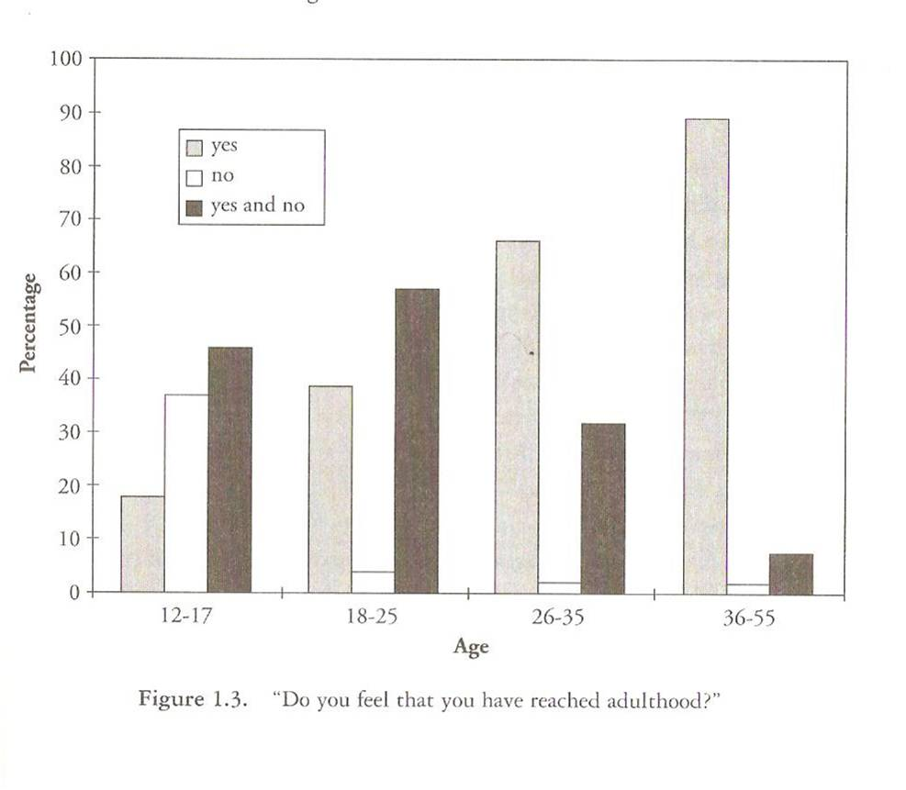
Do you feel you have reached adulthood?
From Arnett JJ 2004

Slide 7
Definition by…?
Age?
Physical changes?
Societal norms?
Legislation?
Culture?
….
“Stage not an age!”
Notes:
Poor indicator of development

Slide 8
Definition by Age
World Health Organization..
Adolescents :10-19 years
Young people: 10-24 years
Youth: 15-24 years

Slide 9
Changing relationship between likely range of menarchal ages and psychosocial transitions that reflect adulthood
30 years
20 years
Menarche
Mismatch of biological and psychosocial transitions*
10 years
Psychosocial maturation
Hunter gatherer
groups
Agricultural settlement
Industrial revolution
Mid 20th Century
Delay and elongation of
psychosocial maturation
20,000 years ago
2,000 years ago
200 years ago
50 years ago
Present day
Adapted from Gluckman & Hanson

Slide 10
2. Understand the biological, psychological and social elements of adolescent development

Slide 11
Key Developmental Tasks of Adolescence
Biological and sexual maturation
  Am I normal?
Personal identity
  Who am I?
Intimate relationships with an appropriate peer
  Am I loveable and loving?
Independence/autonomy
  Am I competent?
Erikson, 1959

Slide 12
Define main developmental goals of early, mid and
late adolescence using the grid as support
 | Early 10-13 yrs | Mid 14-16 yrs | Late 17-19 yrs
Biological/ physical
Psychological/cognitive
Social
Adapted from WHO publications

Slide 13
Growth Spurt
Peak height velocity
  mean age 12 years in girls
  mean age 14 years in boys
average pubertal growth spurt is 25cm
girls have only 3-5cm left to grow after they begin periods (menarche)

Slide 14
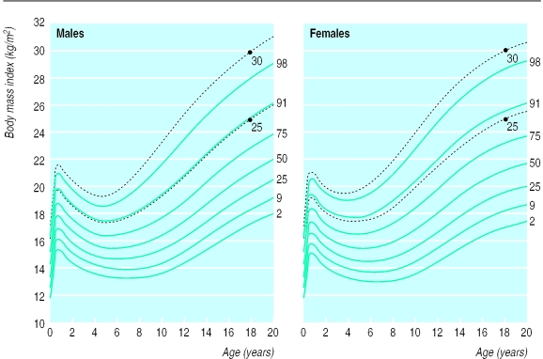
BMI VARIES !
Coles & al, BMJ, 2000

Slide 15
BMI VARIES !
13
12
11
10
9
3
4
4
8
7
2
3
6
Height velocity (cm/year)
2
5
4
3
2
1
0
0
1
2
3
4
5
6
7
8
9
10
11
12
13
14
15
16
17
18
19
Age (years)
Girls
Boys
Fonseca H, Compreender os Adolescentes, 2002

Slide 16
BMI VARIES !
13
12
11
10
9
8
7
6
Growth velocity (cm/year
5
4
3
2
1
0
0
1
2
3
4
5
6
7
8
9
10
11
12
13
14
15
16
17
18
19
Early maturers
years
Late maturers
Fonseca H, Compreender os Adolescentes, 2002
20

Slide 17
Puberty Facts

Slide 18
Vittoz, 2001

Slide 19
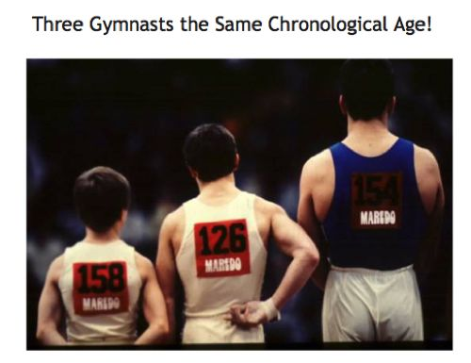
Normal variability 4-5 years
in timing of puberty (M>F)
.

Slide 20
Pubertal timing: a large range
normal
precocious
delayed
years
precocious
delayed
normal
Notes:
Les deux autres phénomènes ont une incidence plus nette sur la santé et le développement des adolescents.
- d'une part, et la diapositive suivante l'illustre, l'âge auquel les premiers signes de puberté apparaissent (début de pilosité pubienne, apparition d'un petit bourgeon mammaire)
Chez le garçon, l'âge du début de la puberté peut être de 9,10,11,12,13 ou 14 ans.
Chez la fille, l'âge pubertaire est décalé d'une année, les filles pouvant commencer leur puberté entre 8 et 13 ans

Slide 21
Pubertal timing in adolescents
8 9 10 11 12 13 14 15 16 17
breast stage 2
breast stage 4
pubic hair stage 2
Females
pubic hair stage 4
menarche
Peak height velocity
adrenarche
Bars show 75th and 25th centiles
for entry into pubertal stages
testicular volume 4ml
testicular volume 12ml
(ejaculation)
genital stage 2
genital stage 4
Males
pubic hair stage 2
pubic hair stage 4
Peak height velocity

Slide 22
While the percentage of body fat increases in females during puberty, it decreases in males.
Notes:
On this slide you can see the % of body fat according to Tanner stages.
Both females and males start puberty with a similar % of body fat, but while females increase that % as you can see, and go out from puberty with more body fat than what they had at Tanner stage 1, with males it’s the opposite: their body fat decreases.

Slide 23
In females, the fact that the adipose tissue increases at a greater rate than the lean body mass, may be misunderstood by the adolescent girl who may think she is overweight

Slide 24
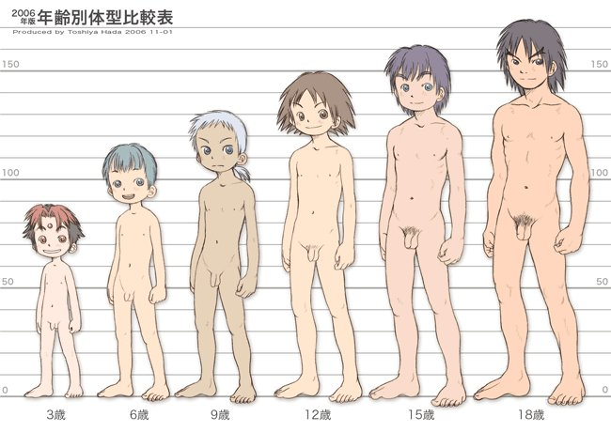
Tanner stages

Slide 25
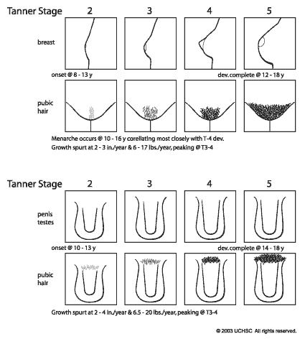
Tanner stages

Slide 26
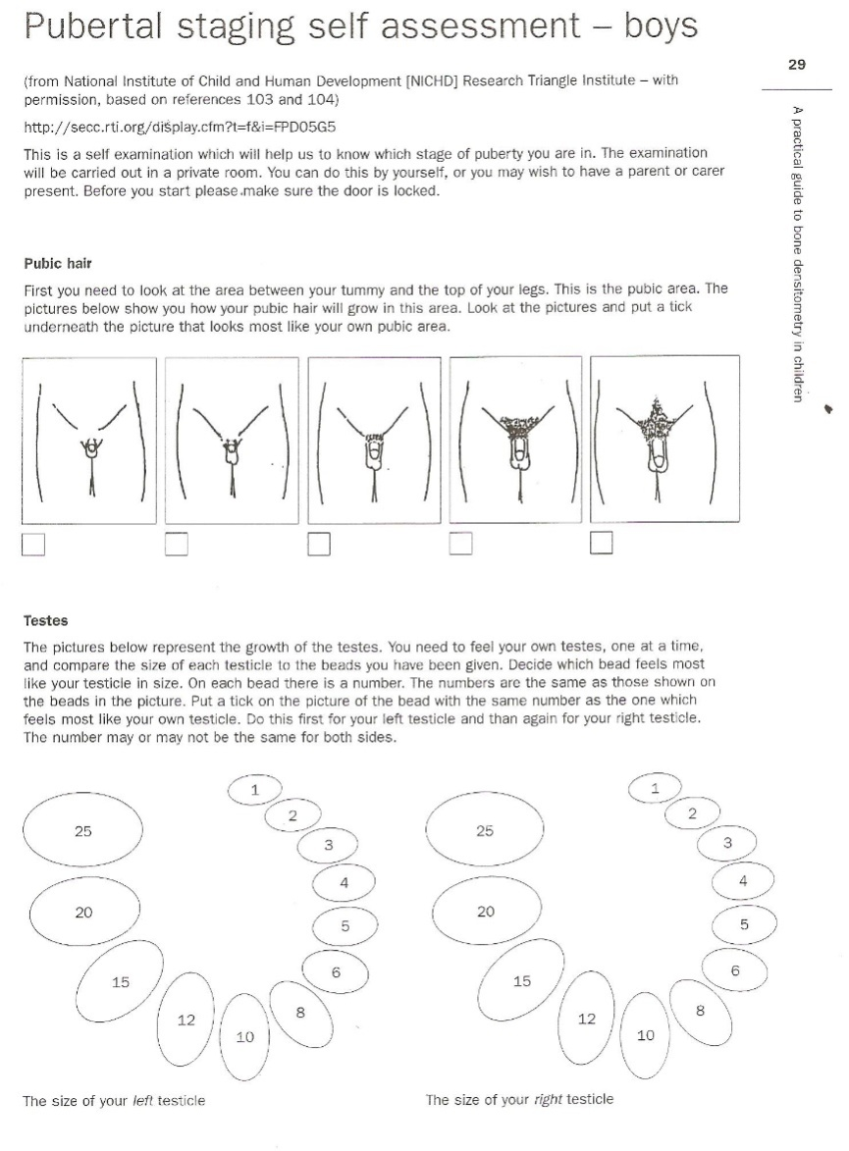
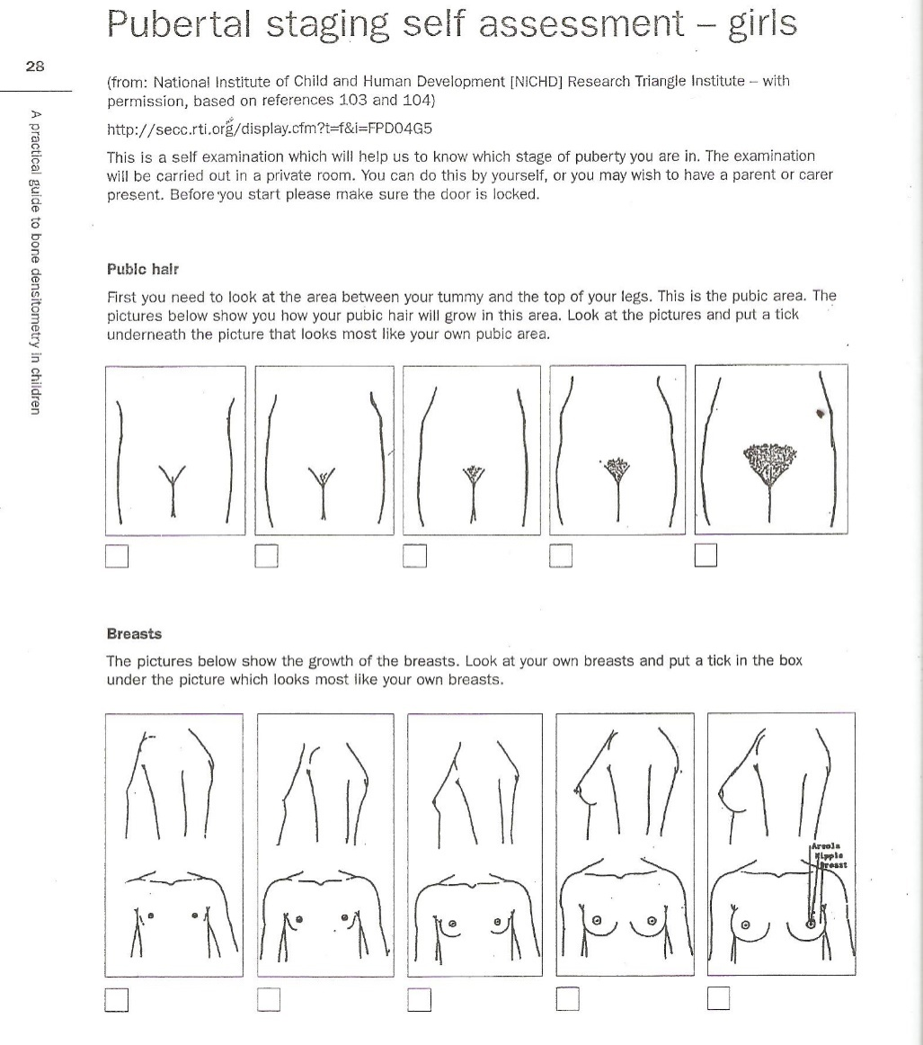
Pubertal Self-Assessment Tools

Slide 27
Reproductive Capacity
Girls
Menarche
Late puberty (Tanner stage 4)
Mean of 13.2 years in UK girls, approximately 2-2.5 years after breast budding.
Males
Spermarche
after 8-12ml testicular volume has been reached.
Sperm in urine (spermaturia) can be found from around 13-14 years in many boys, with most reporting their first ejaculation occurring around the same time.

Slide 28
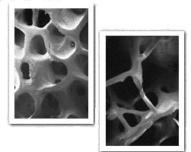
Other Physical Development
Change in
blood pressure
Biochemical changes
eg
Haemoglobin
lipids
enzyme systems
(eg cytoP450)
40% of adult bone mineral density is accrued in adolescence
Notes:
haemoglobin (blood count)
lower in girls due to menstrual bleeding
higher in boys due to androgens
lipids
rise in LDL, fall in HDL in males during puberty
blood pressure
tracks through puberty
enzyme systems
maturation of CytoP450, ALP systems

Slide 29
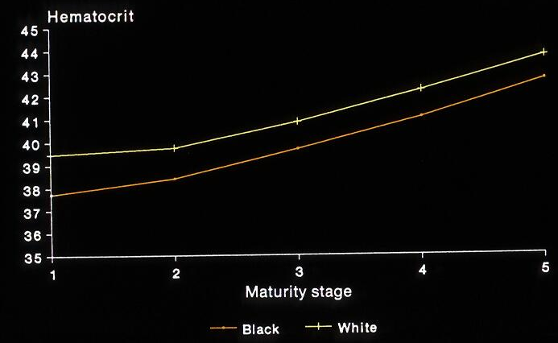
Daniels & al, 1980
Daniels WA, 1980
33

Slide 30
At what age is the brain physically adult?
15-17 yrs
18-19 yrs
22-24 yrs

Slide 31
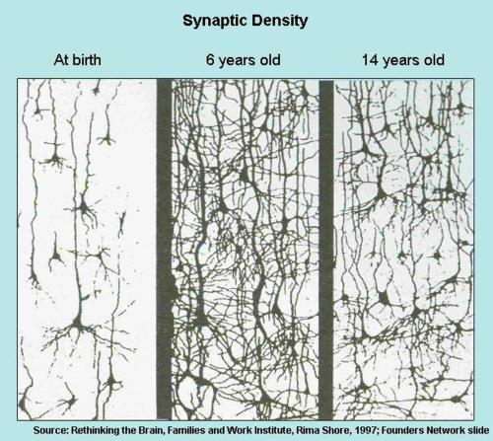
The adolescent brain

Slide 32
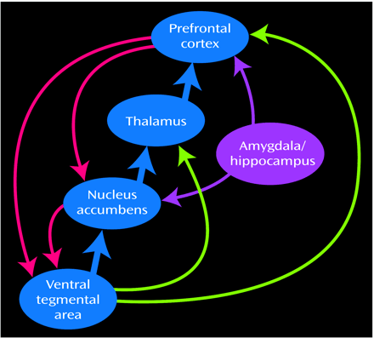
The adolescent brain
Pruning
Late development of
pre frontal cortex
Volkow 2005; Ruben & Baler, 2006;
Goldstein & al, 2002-2007; Giedd, 2008

Slide 33
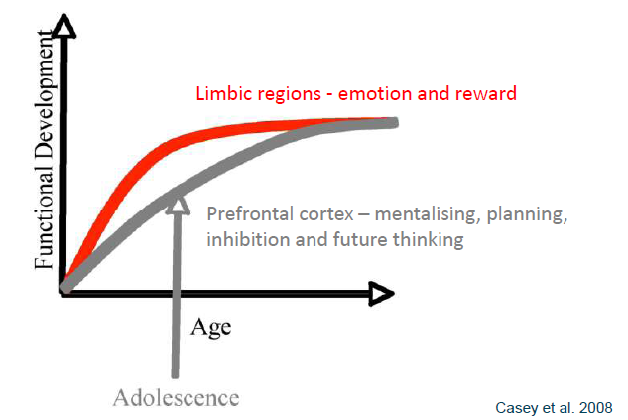
THE ADOLESCENT BRAIN

Slide 34
Psychological
Self concept
Concrete/Abstract Thinking
Body Image

Slide 35
A developmental definition of adolescence: general goals
Separation from the parents
Choice of a professional career
INDIVIDUATION
Sexual orientation
Formation of the self
IDENTITY
FORMATION
WHO,. 2003

Slide 36
WHAT IS ADOLESCENCE ?
the process of autonomisation by which the child becomes more and more reliant on his/her own competences and less dependent on the opinion and support of his/her parents
the acquisition of a stable identity, the permanent feeling that an individual has that he/she knows who he/she is, what his/her life should look like and to some extent how others see him/her

Slide 37
THE ADOLESCENT PROCESS early adolescence (10-13y.)
Intellectual development concrete, egocentric
Autonomisation
  self image centered on pubertal changes
  Independence less interest in parents’ activities
  Intimacy relationships with same-sex friends
Identity
  Sexual increased needs for privacy
  Moral idealistic goals
  Vocational lack of impulse control

Slide 38
THE ADOLESCENT PROCESS middle adolescence (13-16y.)
Intellectual development concrete, but more complex tasks
Autonomisation
  self image making the body attractive
  Independence peak of conflicts with parents
  Intimacy peak peer group activities
Identity
  Sexual exploratory behaviour
  Moral testing of rules
  Vocational first job experiences

Slide 39
THE ADOLESCENT PROCESS late adolescence (17-20 y.)
Intellectual development abstract tasks, logic reasoning
Autonomisation
  self image acceptance of one’s body
  Independence reacceptance of parental support
  Intimacy more intimate relationships
Identity
  Sexual consolidation of sexual identity
  Moral can set limit, ability to compromise
  Vocational choice of vocation/profession

Slide 40
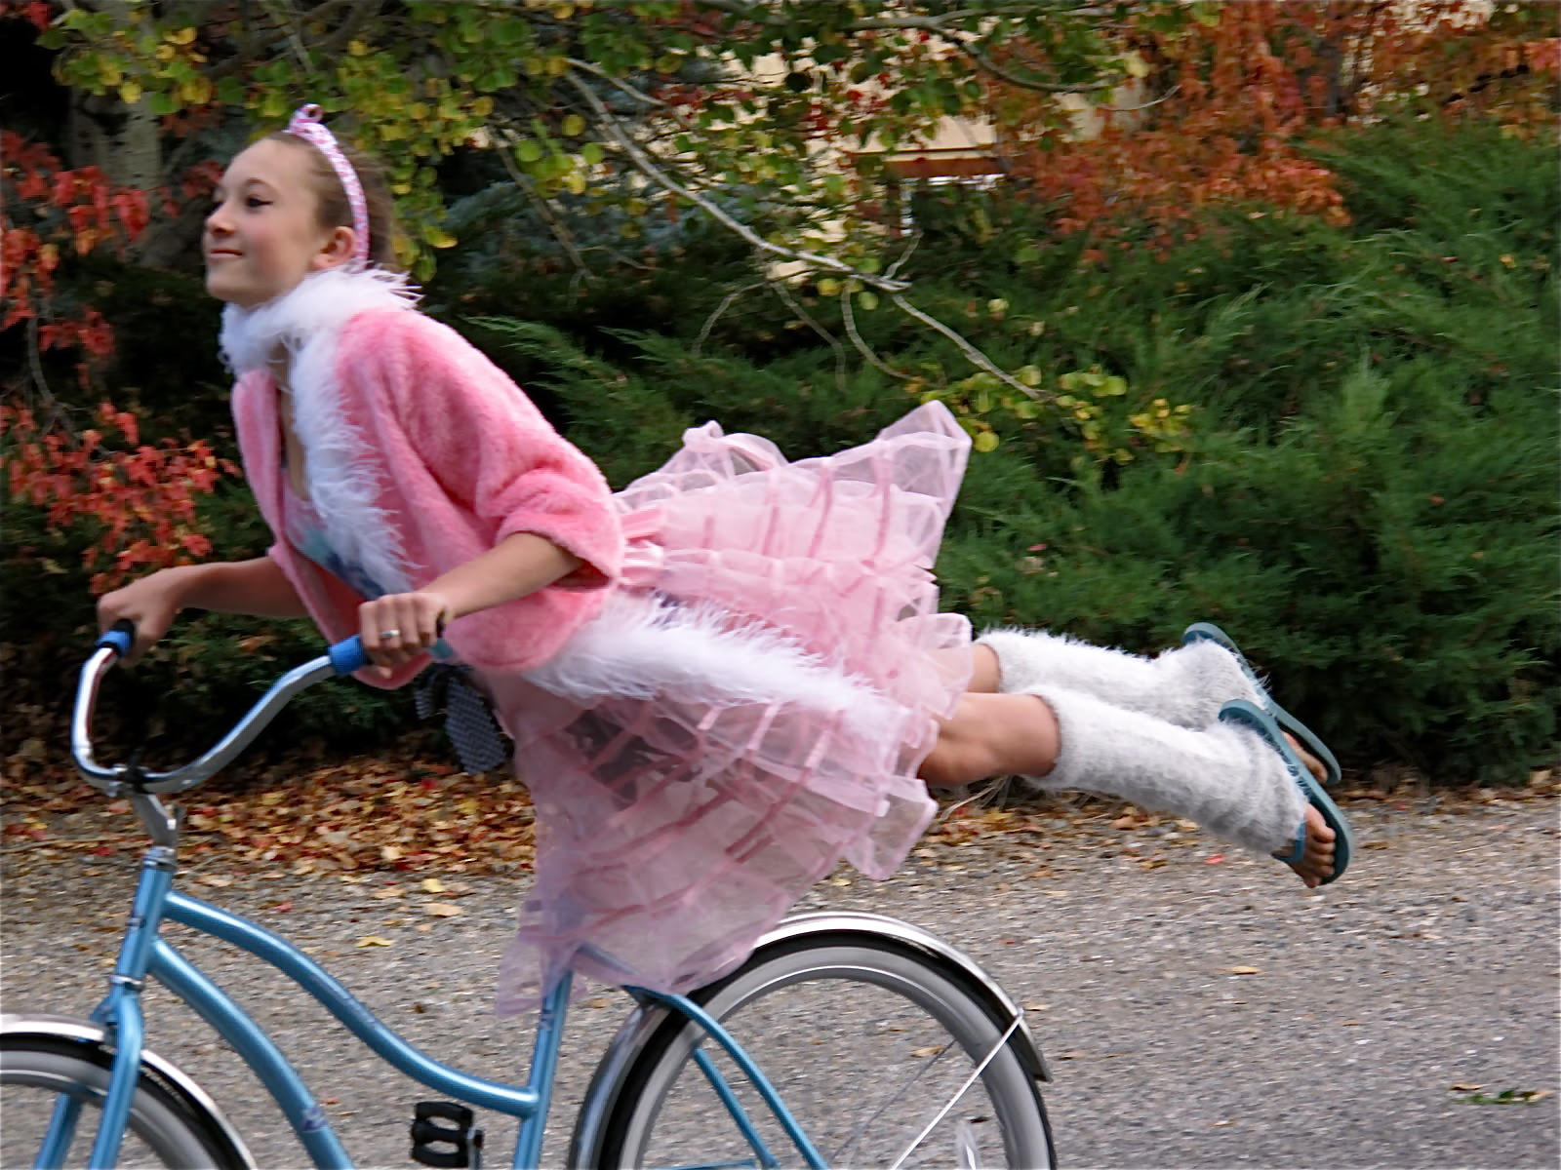
What are your immediate thoughts looking at this picture?
Slide kindly provided by Dr Helena Gleeson

Slide 41
Body Image
Dynamic perception of one’s body
  how it looks, feels and moves
Shaped by perception, emotions, physical sensations
Dynamic – can change in relation to mood, physical experience and environment
Significant physical changes during puberty
Intrinsic influences: eg self-esteem, self-evaluation
Extrinsic influences: eg evaluation by others, cultural messages, societal standards

Slide 42
Body Image
Significant physical changes during puberty
Shaped by perception, emotions, physical sensations
Dynamic – can change in relation to mood, physical experience and environment
Intrinsic influences: eg evaluation by others, cultural messages, societal standards

Slide 43
Who Am I?
Self-concept
There are four components of self-concept:
Physical: relates to concrete attributes
Academic: relates to performance in school
Social: describes how we relate to other people
Transpersonal: describes how we relate to the supernatural or unknowns (moral, religious, ethical)

Slide 44
Development of Self -Concept
Self-esteem can be seen as a measure of how much we value ourselves, particularly in relation to others.
It represents the emotional or feeling component of self-concept.
Requires
  Goals
  Interests
  Values
  Religious belief
  Political beliefs
  Gender
  Sexual identity
  Ethnic identity
  Physical
  Academic
  Social
  Transpersonal
Notes:
Self-concept reflects the beliefs the adolescent holds about him or herself
The extent to which these different beliefs are coherent with each other influences self-esteem
Concept of self as “bullet proof” in mid adolescence

Slide 45
The Concrete Thinker
A young boy with asthma has come to see you in clinic. His mother tells you that he has not been using his inhalers as regularly as you had prescribed. The boy says that he is feeling fine at the moment.
What do you think a young person who has developed concrete thinking skills will believe about the need for inhalers?

Slide 46
The Concrete Thinker
The doctors told me that if I miss my inhalers then I will get sick. But I have forgotten them a couple of times and haven’t got sick, so I don’t think I need them any more.

Slide 47
The Abstract Thinker
A young boy with asthma has come to see you in clinic. His mother tells you that he has not been using his inhalers as regularly as you had prescribed. The boy says that he is feeling fine at the moment.
What do you think a young person who has developed very abstract thinking skills will believe about the need for inhalers?

Slide 48
The Abstract Thinker
I missed my inhalers because I was busy doing an English project and forgot to take them. I think I got away with it because I haven’t been doing a lot of exercise. I think I’ll still need to take them in the future, especially if I am doing lots of exercise or when the weather is cold.

Slide 49
3. Inter-relationships between pubertal timing, psychological development and health behaviours

Slide 50
WHAT WE KNOW ABOUT GIRLS
Early maturing adolescent girls tend to:
Suffer from mental health problems in a higher proportion (depression)
Have a disturbed body image in a higher proportion
Engage earlier in sexual activities including sexual intecourse (& number of partners)
Engage in exploratory behaviour (i.e. substance use) in a higher proportion
Patton G, Lancet 2007

Slide 51
WHAT WE KNOW ABOUT BOYS
late maturing boys do suffer from mental health problems more often and have a disturbed body image in a higher proportion
HOWEVER, early maturing boys, as girls do:
Suffer from mental health problems in a higher proportion (depression)
Report early sexual activities a higher proportion
Engage in exploratory behaviour & delinquant behaviour in a higher proportion
Patton G, Lancet 2007

Slide 52
THE IMPACT OF PUBERTY
The « booster » of the adolescence process
The adaptation to a new body image
  physiological clumsiness
  fatigue
  sexual arousal
Exploratory behaviour, sensation seeking

Slide 53

BODY IMAGE
%
Michaud & al, Molec Cell Endocrinol 2006

Slide 54
DEPRESSION
%
Michaud & al, Molec Cell Endocrinol 2006

Slide 55
SCHOOL ACHIEVEMENT
%
Michaud & al, Molec Cell Endocrinol 2006

Slide 56
CANNABIS USE
%
Michaud & al, Molec Cell Endocrinol 2006

Slide 57
SEXUAL INTERCOURSE
%
Michaud & al, Molec Cell Endocrinol 2006

Slide 58
TO SUMMARIZE ..
Among girls, early maturation seems transiently associated with body image disturbance, mental health problems, early initiation of exploratory behaviour and missed educational opportunities
Among boys, early maturation seems transiently associated with early initiation of exploratory behaviour
Among boys, BOTH early and late maturation seems transiently associated with body image disturbance, mental health problems and missed educational opportunities
This situation increases the current mismatch between biological/pubertal development and the expectation of the society towards these adolescents

Slide 59
HYPOTHESES
Pubertal
timing
Neuro biological
effects
Developmental
problems
Mental health
problems
Peer
pressure
Education
Michaud & al. 2006

Slide 60
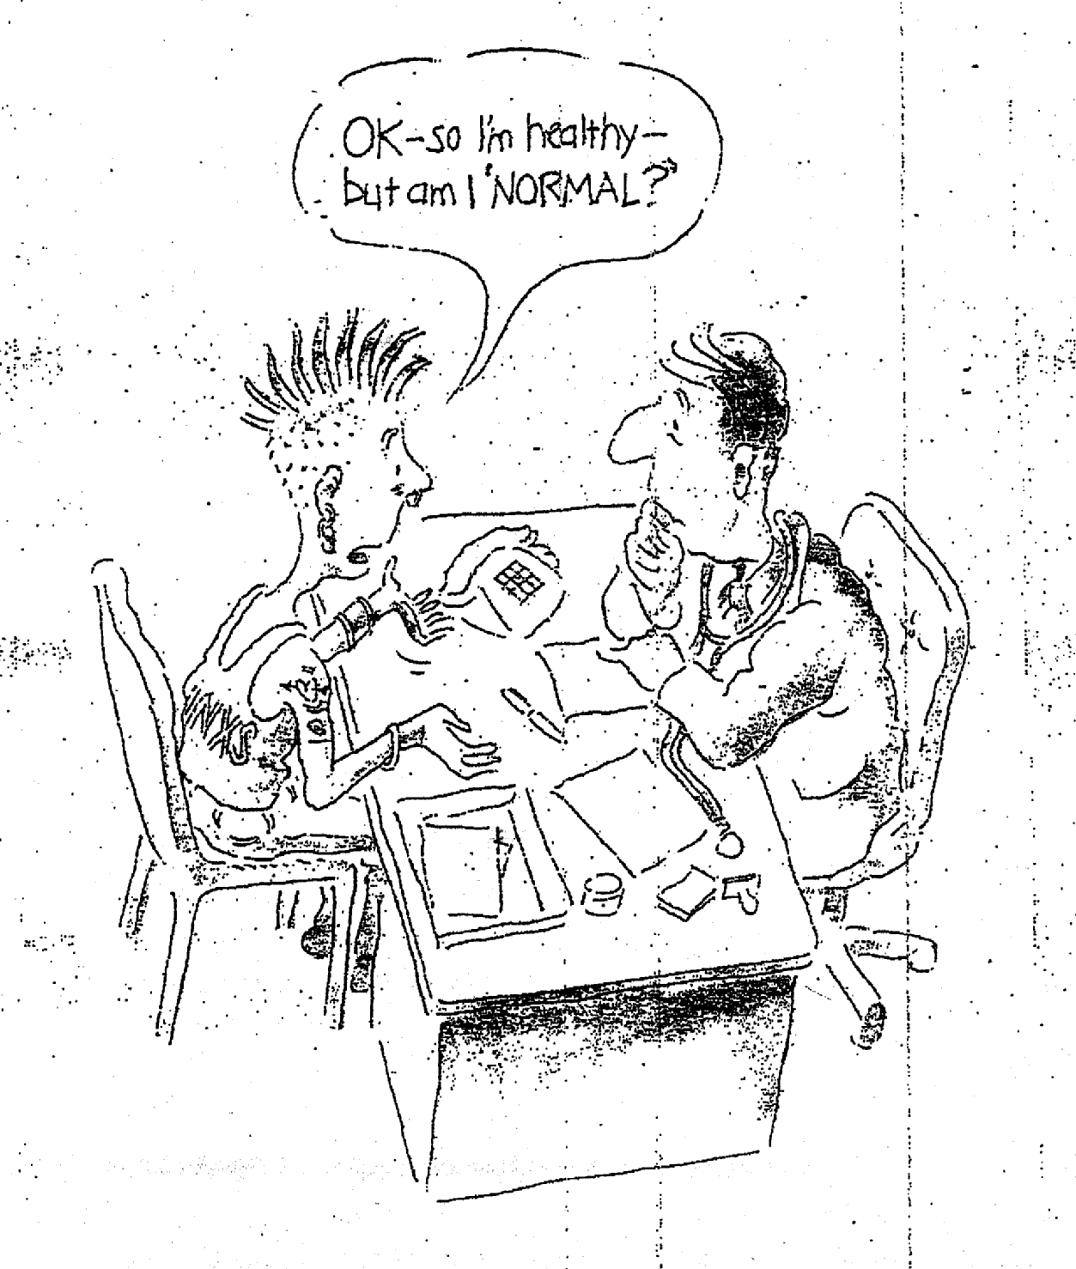
What is a normal
adolescent ?
Reproduced with kind permission from David Bennett, Sydney
Notes:
The task for providers meeting young people in their consultation can sometimes be rather difficult, as illustrated on this cartoon.
The GP on this picture would probably look less perplexed if he had attended one of the adolescent health training workshops
my colleagues Lena Sanci in Melbourne or Anne Meynard in Geneva are running

Slide 61
WARNING SIGNS
Decreased school/vocational achievement
Isolation, lack of relationship
Violence, deviant behaviour
Physical/functional symptoms

Slide 62
THE “NORMAL” ADOLESCENT
A normal adolescent has a flexible behaviour which evolves over time, and keeps creativity in at least some areas.
Usually has a good relationship with at least 1-2 peers.
One does not judge normality only in terms of behaviour but must reflect on the meaning of any behaviour and the context in which it takes place.
Some behaviours are acceptable for older adolescents but may be less acceptable at younger ages.

Slide 63
PSYCHOLOGICAL BURDEN:
CRITERIA
Duration of the symptoms
  > 3 months
Instability of symptoms
Symptoms which heavily impact on the adolescent’s daily life (family/school environment)

Slide 64
Social
Within the family
Within the peer /friendship group
Exploratory behaviours
Vocational development

Slide 65
Social Development during adolescence
Early adolescence
Realisation of differences from parents
Beginning of strong peer identification
Early exploratory behaviours

Slide 66
Social Development during adolescence
Mid adolescence
Emotional separation from parents
Strong peer group identification
Exploratory/risk behaviours
Sexual peer interests develop
Early notions of vocational future

Slide 67
Social Development during adolescence
Late Adolescence
Development of social autonomy
Development of intimate relationships
Development of vocational capability

Slide 68
Friends vs Peers
Friendship groups
small, close-knit groups
give support & companionship
reaffirm self-identity
Usually begin in school
Strengthened by time outside school
Exclusivity increases with age
Peer Groups
same-age and gender
Framework of norms for behaviours and values
Sampling
- include
Subcultures/types
Local crowds/tribes – reflect wider peer norms in community; reputation-based groups of similarly stereotyped adolescents
?? On-line Friends
Notes:
Just as in adults….
Friendship gps within peer gps
More research with peers> friendships

Slide 69
Friends are important!
Horizontal relationships
Support
Mutual activity involvement
Positive mental health
Development of identity
Self-confidence
Decision-making
Empathy
Promotion of interpersonal skills eg. intimacy, communication, conflict resolution, disclosure
Notes:
Skills important for social navigationof the relationships they develop in the process of growing up

Slide 70
VocationAL identity
Individuals go through stages of vocational identity
Childhood Fantasy
Pre- adolescence Tentative
Late adolescence Realistic

Slide 71
Vocational Readiness
Educational achievement
Prior work experience
Communication skills
Expectations of young person & family; professionals
Psychological e.g. self-esteem
Knowledge re: resources, rights etc

Slide 72
Biological
Secondary sexual characteristics
Reproductive capacity
Growth spurt
Bone density
  Brain development
Psychological
Self concept
Concrete/Abstract Thinking
Body Image
Social
Within the family
Within the peer/friendship group
Exploratory behaviours
Vocational development

Slide 73
AN INTEGRATIVE Approach to ASSESSMENT of
Adolescent Development
Growth and sexual maturation
Is the intellectual, pubertal and growth stage appropriate for his/her chronological age?
Thinking
Is the young person using concrete or abstract constructs?
Does he/she have sufficient self-esteem and/or future prospect ?
Peers/Parents
How connected is the young person to the peers and parents?
Who is responsible for the young person’s health care decisions?
Education/Employment
Is the young person involved in an education/training activity that is, in the cultural context, appropriate for his/her age?

Slide 74
ADOLESCENCE: THREE STAGES
 | Early 10-13 yrs | Mid 14-16 yrs | Late 17-19 yrs
Biological/ physical
Psychological Cognitive
Social
WHO ~2000

Slide 75
Define main developmental goals of early, mid and late adolescence
 | Early 10-13 yrs | Mid 14-16 yrs | Late 17-19 yrs
Biological/ physical | Girls breast bud and pubic hair dev (Tanner Stage II) initiation of growth spurt Boys testicular enlargement, beginning of genital growth (Stage II) | Girls mid to late puberty (Stage IV-V) completion of growth; menarche (Stage IV event); development of female body shape with fat deposition Boys mid puberty (Stages III & IV) spermarche & nocturnal emissions; voice breaking ; initiation of growth spurt (Stage III-IV) | Boys completion of pubertal development (Stage V) continued androgenic effects on muscle bulk and body hair Brain development Increase in bone mineral density
Psychological/ cognitive | thinking remains concrete but with development of early moral concepts progression of sexual identity development: development of sexual orientation reassessment and restructuring of body image in face of rapid growth | emergence of abstract thinking although ability to imagine future applies to others rather than self (self seen as "bullet-proof") growing verbal abilities; adaptation to increasing educational demands conventional morality (identification of law with morality) development of fervently held ideology (religious/political | complex abstract thinking post-conventional morality (ability to recognise difference between law and morality) increased impulse control further completion of personal (and sexual) identity further development or rejection of Ideology and religion
Social | Realisation of differences from parents Beginning of strong peer identification Early exploratory behaviours | Emotional separation from parents Strong peer group identification Exploratory/risk behaviours Heterosexual peer interests develop Early notions of vocational future | Development of social autonomy Development of intimate relationships Development of vocational capability

