Slide 1
WELCOME TO THE 2013
Nutritional requirements during adolescence
Main resource: Stang J, Story M (eds). Guidelines for adolescent nutrition services, 2005 (www.epi.umn.edu/let/pubs/adol_book.shtm)
1

Slide 2
Objectives
Know the specific nutritional requirements during adolescence
Apply this knowledge to the situation in your country

Slide 3
In your country
What is your major concern about adolescent nutrition?
  What are the food groups for which your adolescents have difficulties to reach an adequate intake?
What are the influences on what and how adolescents eat?
What could be done to increase Vit D levels?

Slide 4
Puberty = Changes in weight, body compositition and skelettal mass
50% of ideal body weight is gained during adolescence
Growth spurt
=>nutrition needs parallel the growth spurt
=>at peak of growth spurt nutrition needs about 2x that of rest of adolescence
Before puberty:
nutrition needs of girls = boys

Slide 5
Sex diffences of body composition
Girls
Lean body mass falls from 80%→74%
Body fat increases from 16%→ 27%
Boys
Lean body mass doubles during adolescence (reaches about 88%)
Fat: decreases to 12% of body mass

Slide 6
Sex diffences of body composition (2)
During Puberty
Girls get taller and fatter
Boys get taller, leaner and denser (bone mass)

Slide 7
Influences on nutritional requirements
Body and muscle mass
Basic metabolic rate (closely associated with lean body mass)
Pubertal growth
Physical activity
Girls: Menarche

Slide 8
Food groups: diagramm
Carbohydrates
Protein
Fat
Fibers
Minerals => Calcium, Iron, Zinc
Vitamins
Energy

Slide 9
carbohydrates
55-60% of total energy
<10% of sugars
What about your adolescents?
Notes:
In the us there is 16% of total energy for soft drinks

Slide 10
Protein
Protein Need = need for maintenance of lean body mass + accrual of lean body mass
=> highest during PHV
Girls 11-14y (ca. 46g/d)
boys 15-18y (ca. 59g/d)
Lack of adequate protein intake: reduction
  linear growth
  Sexual maturation
  Accumalation of lean body mass
Notes:
RDA 9-13y: 0.95g/kg/d
14-18y 0.85g/kg/d

Slide 11
fats
Recommendation < 30% (25-35%) of fat of total energy consumed
< 10% of saturated fat
Notes:
Quelle: Stang and Story, 2005

Slide 12
Dietary fiber
AAP: 0.5g Fiber/kg/d
(or teens Health: age plus 5mg/d,
i.e. 14y =19mg/day)
Or 15 -34.5g for Males 10-18y
Or 16.8-28.5 g for girls 10-18y
Sources whole grain, fruits, green peas, artichokes, almonds
Notes:
DRI = daliy reference intake or daily recommended intake

Slide 13
Minerals: calcium
Females have the greates capability of absorbing calcium at time of menarche decreasing thereafter.
  At age 17y 90% of adult bone mass is reached
By age 24y (female) and 26 (male) calcium accretion is almost nonexistent

Slide 14
Importance of bone mass accretion

Slide 15
Calcium (2)
DRI 9-18y 1300mg/d
Sources for calcium:
  Milk (g /l
  Cheese
  Yoghurt
  Soy, beans
  Fortified food
  Consumption of soft drinks may displace other good nutrition
Most US American teenagers eat only about 2/3 of Calcium needed => SaudiArabia?
Most

Slide 16
Minerals: Iron
Increase of blood volume during puberty
Menarche
DRI: adolescent boys 12mg/d, girls 15mg/d
Sources meat, fish and poultry

Slide 17
Minerals: Zinc
Important for many enzymes, growth and sexual development
RDA: m/f 9-13y: 8mg/d
14-18y: m:11mg/d, f 9mg/d
Sources: red meat, shellfish, whole grains, fortified cereals etc.
!!!Many plant-based zinc sources contain fibers that inhibit zinc absorption!!!
➔ Vegetarians at risk!

Slide 18
Types of vegetarian diets
Type of vegetarian diet | Food excludes
Semi- or partial vegetarian | Red meat
Lacto-ovo veg. | Meat, poultry, fish, seafood
Vegan (total vegetarian) | Meat, poultry, eggs, seafood, fish, dairy products, honey etc.
macrobiotic | Meat, poultry, eggs, dairy, seafood, fish (not in all macrobiotic vegetarians)

Slide 19
Vitamins:
Folate
DRI 300μg (9-13y)
400μg (14-18)
Sources: cereal, milk, orange juice, bread, dried beans, lentils
Deficiency:
  Risk of megaloblastic anemia (rare in adolescence)
  Risk of congenital malformations for offspring (e.g. spina bifida)
  ➔ supplement women capable of pregnancy with 400μg/d??

Slide 20
Vit d
Important for bone accretion, innate immunity
Insufficiency: 50-80nmol/L
deficiency: <50nmol/L
(!! Levels go up with PTH rise due to bone demineralization!!)
➔ adolescents in many countries are deficient (incl. Germany, Turkey, Ireland...Saudi Arabia)
Recommended intake: 400 IU Vit D/d (AAP 2008)
From Wagner et al, Pediatrics 2008

Slide 21
Vit D: what would your adolescents need to eat?
Food | IU per serving* | Percent DV**
Cod liver oil, 1 tablespoon | 1,360 | 340
Salmon, cooked, 3.5 ounces | 360 | 90
Tuna fish, canned in oil, drained 1.75 ounces | 200 | 50
Milk (nonfat, reduced fat, and whole), Vitamin D-fortified, 1 cup | 98 | 25
Ready-to-eat cereal, fortified with 10% of the Daily value for vitamin D, 0.75-1 cup | 40 | 10
Egg, 1 whole (vitamin D is found in yolk) | 20 | 6
Cheese, Swiss, 1 ounce | 12 | 4
*International Units**Daily Value based on recommended 400 IU for children.Source: National Institutes for Health, Office of Dietary Supplements (www.healthychildren.org)

Slide 22
Vit B12
Important for red cells→ blood volume during adolescence increases
Sources: meat, eggs and fortified cereals
Recommendation for ados 2.4micrograms per day
Vegetarians might need supplementation

Slide 23
Vit a
Important for vision, reproduction, growth and immune system
DRI 600-900 mg/d dependent on age and sex
Sources: cereal, milk, carrots, cheese (story 2005

Slide 24
Vit c
Important for absorption of iron and calcium, aids in would healing and contributes to brain function (story 2005)
DRI: 45-75mg
Sources citrus fruits, tomatoes, potatoes

Slide 25
Remark on coffein
Consumption should be less than 100mg per day
Caffeine is diuretic→dehydratation
Causes loss of calcium in the body

Slide 26
In your country
What is your major concern about adolescent nutrition?
  What are the food groups for which your adolescents have difficulties to reach an adequate intake?
What are the influences on what and how adolescents eat?
What could be done to increase Vit D levels?

Slide 27
Useful resources
Stang J, Story M (eds). Guidelines for adolescent nutrition services, 2005 (www.epi.umn.edu/let/pubs/adol_book.shtm)
Teens Health. Nemours. www.kidshealth.org/teen
Adolescent nutrition www.fays.org/nutrition/A-ap/adolescent-nutrition.html
https://www.choosemyplate.gov/sites/default/files/tentips/DGTipsheet36EatSmartAndBeActiveAsYouGrow.pdf

Slide 28
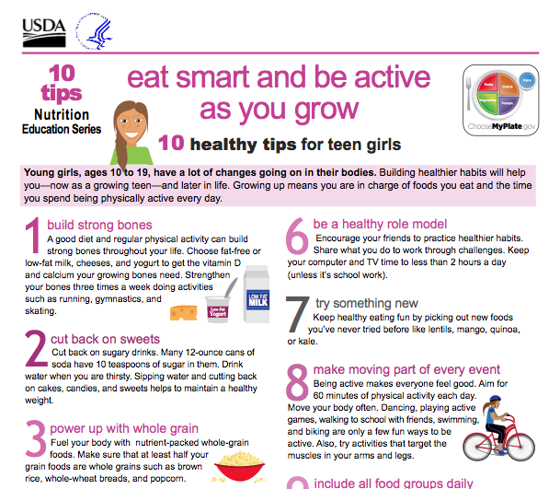

Slide 29


Slide 30
Adolescent Obesity
Summer School July 2017
Helena Fonseca MD, MPH, PhD
helenaregalofonseca@gmail.com

Slide 31
How much is too much?
Notes:
Este estudo forneceu um forte evidência de que…

Slide 32
By the end of this session you’ll be able to:
I. Describe the obesity tracking and comorbidities
II. Evaluate the nutritional and exercise status of an adolescent in the context of his/her bio-psychosocial development.
III. Plan appropriate intervention for, and manage the adolescent who is overweight.
IV. Assess the need in different settings for health promotion regarding obesity, and develop relevant strategies.

Slide 33
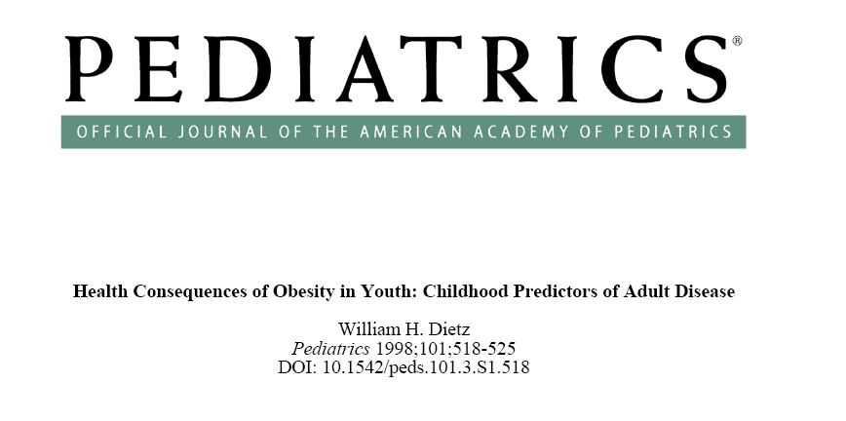

Slide 34
Probability of becoming an obese adult
Among children below 10, either obese or non-obese, parental obesity doubles the risk of becoming obese as an adult.
Whitaker RC, Wright JA et al.
N Engl J Med 1997; 337: 869-73
Notes:
Sabemos que … e também que

Slide 35
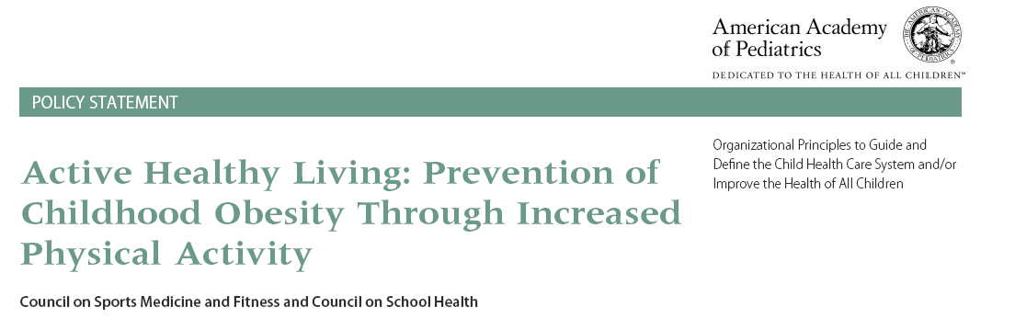
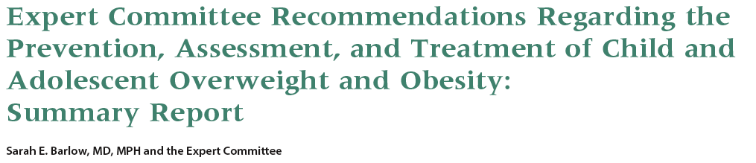
Pediatric Obesity: Guidelines
Notes:
Essas associações têm vindo a lançar tomadas de posição e guidelines sobre o combate à obesidade pediátrica.
Salientam-se as mais recentes da AAP e da Sociedade de Medicina Adolescente
A promoção da AF é um dos aspectos fulcrais trabalhados nestes documentos

Slide 36


Obesity: Long-Term Positive Energy Balance
Fat
Stores
Notes:
Obesity is caused by long-term positive energy balance
Obesity is caused by ingesting more energy than is expended over a long period of time. The excess calories that are consumed lead to an accumulation of body fat either by being stored as fat or preventing the mobilization and oxidation of endogenous fat. In general, ingesting 3500 kcal more (or less) than expended will lead to a gain (or loss) of approximately 1 lb of fat. Genetic factors may influence the amount of weight gained with overfeeding. In one study, weight gain varied greatly among 12 monozygotic twin pairs who were chronically overfed 1000 kcal/d [1]. However, weight gains were very similar within each member of a twin pair. In another study, body fat gain after 8 weeks of overfeeding also varied among study subjects but was inversely related to changes in non-volitional energy expenditure, such as fidgeting, which may be determined genetically [2].
Bouchard C, Tremblay A, Despres JP, et al. The response to long-term overfeeding in identical twins. N Engl J Med 1990;322:1477-1482.
Levine JA, Eberhardt NL, Jensen MD. Role of nonexercise activity thermogenesis in resistance to fat gain in humans. Science 1999;282:212-214.

Slide 37
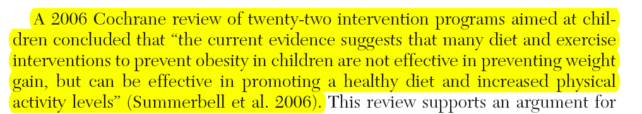
Weight Managment = Weight (BMI) Loss?
Better Diet
Increased PA
Weight (BMI) Loss
Oude Luttikhuis H, Baur L, Jansen H, Shrewsbury VA, O'Malley C, Stolk RP, Summerbell CD. Interventions for treating obesity in children. Cochrane Database Systematic Rev 2009

Slide 38
Walking Stick
• List the short-term and long-term risks of an inappropriate dieting and physical activity in adolescence, with special attention to obesity

Slide 39
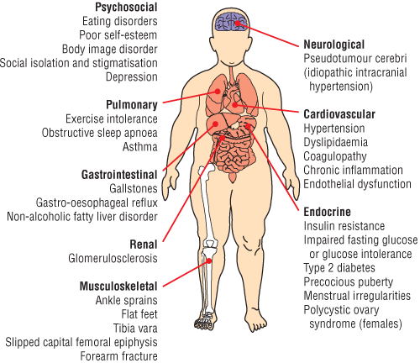
Ebbeling CB, Pawlak DB, Ludwig DS.
Lancet 2002; 360: 473-82

Slide 40
Percentage of body fat during puberty
Tanner Stages | % Body fat
 | Males | Females
1 | 14,3 | 15,7
2 | 11,2 | 18,9
3 | - | 21,6
4 | - | 26,7
5 | - | -
Neinstein L. Adolescent Health Care
Notes:
Body compartments change a lot throughout adolescence and they do not grow all at the same
time.
For example the adipose mass increases at a great rate in females and as you can see here, the % of body
fat increases in females during puberty and decreases in males in whom lean body mass
increases due to increased muscle mass from circulating androgens. This increase in adipose
tissue in girls together with pelvic remodelling may predispose for discomfort regarding body
image and may predispose for disordered eating.

Slide 41
Aims of obesity assessment
• To categorise cardiovascular risk profile
(elements of the insulin resistance syndrome: fasting
hyperinsulinaemia; hypertension; dyslipidaemia; waist
circumference)
• To identify current or potential complications of obesity
• To exclude secondary causes of obesity
- genetic causes (e.g.Prader-Willi syndrome)
- endocrine syndromes such as hypothyroidism and Cushing's syndrome

Slide 42
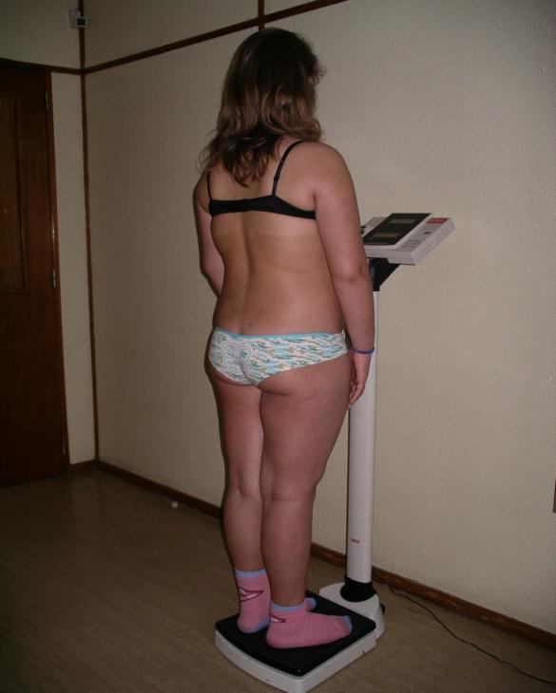
Weight and height
  Frankfurt horizontal plan
Notes:
42

Slide 43
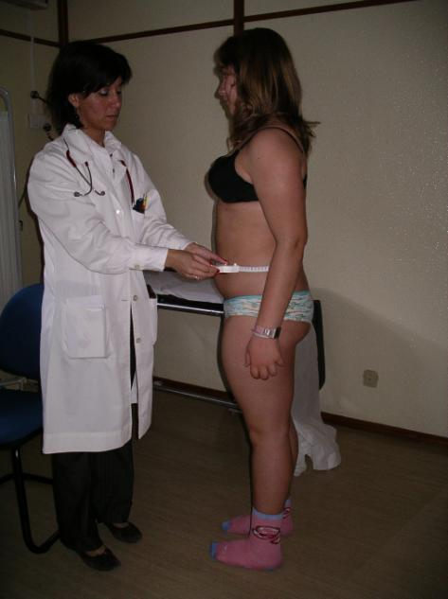
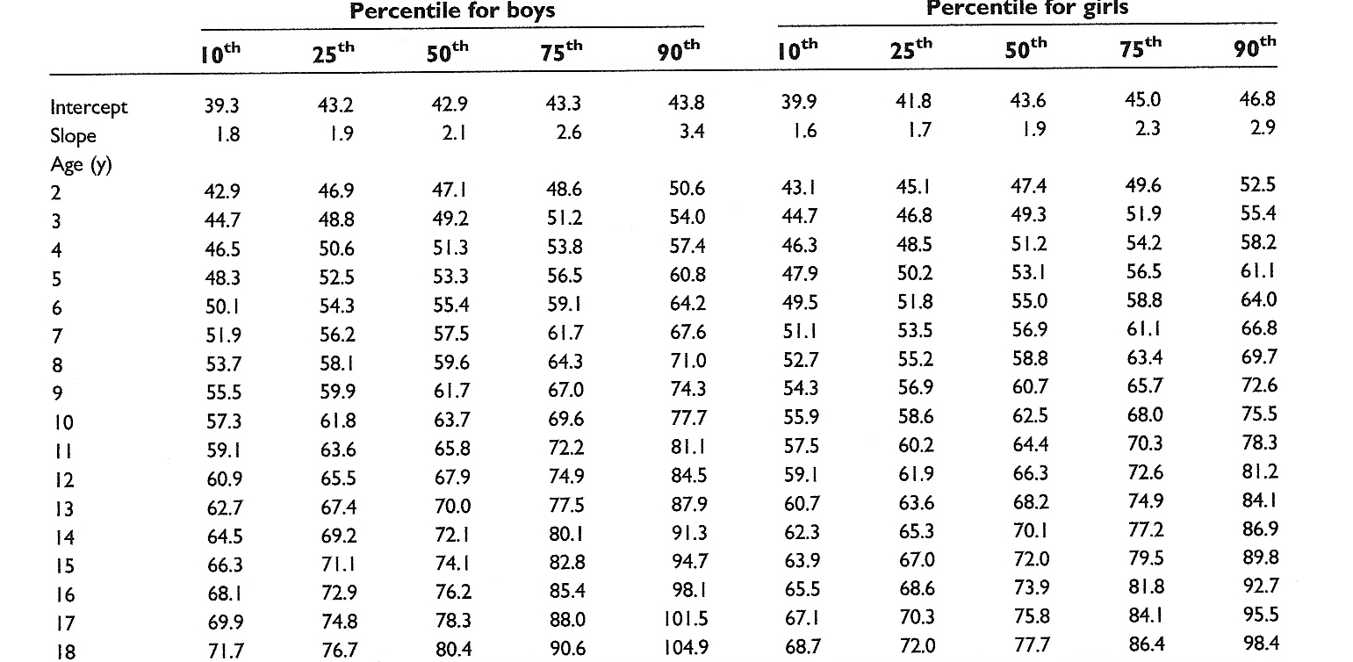
Waist circumference
Cameron Method
Notes:
O mesmo se passa com o perímetro abdominal. Fornece informação indirecta sobre sobre a adiposidade visceral, que por sua vez se correlaciona com os factores de risco cardiovascular e metabólico e tem a vantagem de ser de execução mais fácil do que as pregas mas não existem disponíveis valores de referência para crianças que identifiquem o risco para além do risco já atribuído fruto da categorização do IMC. Quando houver pontos de corte que permitam obter informação adicional e influenciar a avaliação ou a terapeutica, aí sim a medição do PA passará a ser um instrumento útil.
43

Slide 46
BMI Z-Score (distance to the mean)
BMI Z - score =
( real BMI - Mean)
SD
< - 1,65 | < P₅
< - 1,04 | < P₁₅
0 | P₅₀
> 1,04 | > P₈₅
> 1,65 | > P₉₅
Notes:
A distância do IMC ao P₉₅ pode configurar realidades médicas e psicossociais muito diversas.

Slide 47
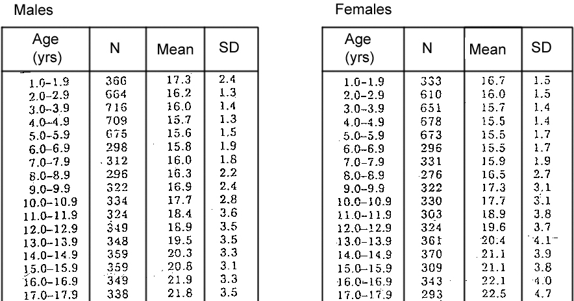
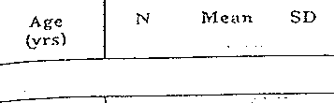
BMI Z-Score
Notes:
47

Slide 48
Labs
CBC, fasting glucose, BUN/cr, uric acid, liver function, insulin, fasting lipid panel
OGTT: fasting glucose ≥ 100 mg/dl
→ Cardiometabolic risk (BP, fasting lipid profile, insulin resistance)
→ Identification of co-morbidities

Slide 49
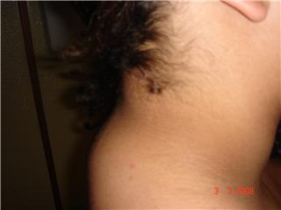
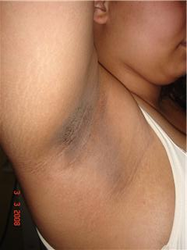
Acantose nigricans
HOMA-RI
IO (µU/ml) x GO (mmol/l) → N: 2.06 +/- 0.14
22.5
Notes:
Doença de Blount (tíbia vara) ocorre + frequentemente em crianças obesas e o seu início habitualmente tem lugar após os 8 anos.
Epifisiólise da cabeça do femur entre os 9 e os 16 anos, afecta + os rapazes, incidência estimada de 11 casos /100.000 crianças. Também ocorre + frequentemente quando a criança é obesa
49

Slide 50
Circulation. 2006; 114:1056–1062
♂
♀
Notes:
50

Slide 51
Adolescence
Journey from the world of the child to the world of the adult
- physical changes
- greater independence
- increasingly relying on peers
- personal identity
Coming to the office: Unique opportunity for discussing body satisfaction, lifestyle and socialization issues.
Notes:
51

Slide 52
Defining the range of adolescent body shape

Slide 53
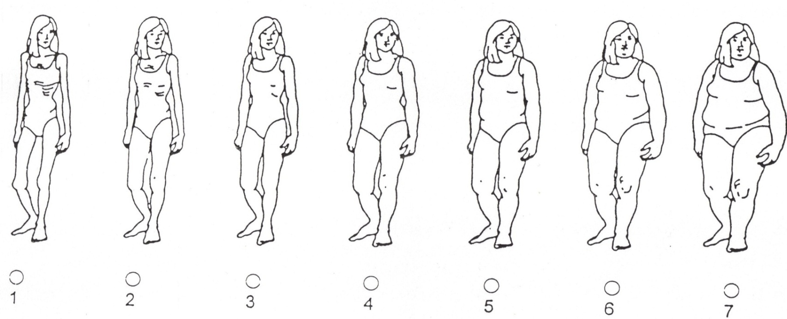
Body Image Assessment
Thin
Average
Overweight
Collins ME. Int J Eat Dis 1991; 10: 208-17.

Slide 54
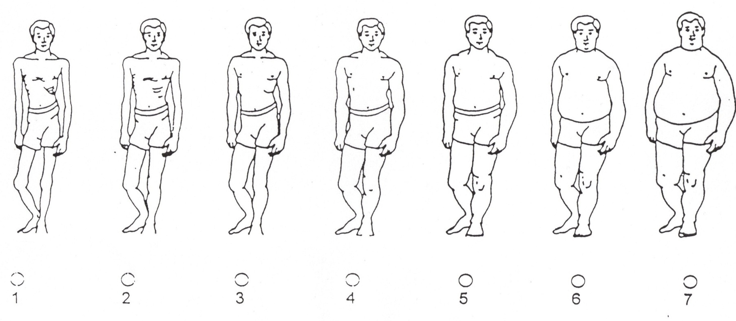
Body Image Assessment
Thin
Average
Overweight
Collins ME. Int J Eat Dis 1991; 10: 208-17

Slide 55
History taking …
. Plotting the "obesity trajectory“
Birth weight
Early feeding history
Onset of obesity:sudden or gradual? At what age?
Progression of obesity: rapid or gradual?
Any periods of very rapid weight gain, particularly recently?
Any periods of weight loss (why and how achieved)?
Who else in the family is obese or has trouble controlling weight?
. Family risk profile
Morbid obesity; type 2 diabetes; hypertension; dyslipidaemia; polycystic
ovarian syndrome; early cardiovascular disease.
. Assessment of individual and family motivation
. Body image assessment

Slide 56
Role Play
A 13 year-old girl who comes to the clinic with her mother was referred by
the school physician because she is gaining weight although she has
practically stopped growing. The father is unemployed and the mother works
as a housekeeper. The girl started regular menses two years ago. She never
eats breakfast, eats few vegetables and fruits, and no meat. She is quite
sedentary, does not like the school exercise class, and spends several hours a
day watching TV. Although the mother says her daughter complains about
the size of her hips, the girl denies this. She has very few friends. Past history
is unremarkable except mild asthma treated with antihistamines and inhaled
corticosteroids. There is no family history of early cardiovascular disease or
type II diabetes.
From the school visit report, you calculate a BMI of 26, which is above the
97th centile for age and gender and is in excess of 36 % above normal weight
for height. The girl did not want to come and does not want to be examined.
The mother insists on an exam, and wants a blood test to rule out a hormonal
problem.

Slide 57
Role Play
After the mother has left the examining room, the girl explains that having gained weight rapidly bothers her and that she feels different from her peers. She thinks a dietician cannot help her and she doesn't know what to do. You propose that she make another appointment at the clinic, at which time you will examine her. You explain the possible options, emphasizing to her how important it is that she reflects on her choices and her future, and ask her to be open to discussing the situation with other professionals. At the end of the visit you summarize your findings for the mother, indicating that a blood test, which the daughter would not easily accept, is not required at this time and could be discussed at a later stage.

Slide 58
Identify the potential facilitators and barriers that need to be taken into account once developing a management plan
-Spider Web-

Slide 59
Select among the possible interventions in a multidisciplinary setting those most appropriate for overweight adolescents
(Pay attention to the most common adolescent concerns and complaints related to body image) small group + plenary review

Slide 60
Dieting Behaviours
6.4%
17.2%
34.6%
Normal BMI
Diet
to loose weight
Normal BMI
No diet
Needing to
loose weight
BMI ≥ P₈₅
No diet
Happy with
own weight
Fonseca H. et al.
How much does overweight impact the adolescent developmental process?
Child: care, health and development 2010; 37 (1): 135-142.

Slide 61
Fonseca H, Matos MG, Guerra A, Gomes-Pedro J
Acta Paed 2009; 98: 847-52
HBSC Study (Portuguese dataset)
Unhealthy weight control behaviours were significantly more commonly reported:
- by those who were dieting
- among those who, although not being on diet, felt they should.
Unhealthy weight control behaviours increased proportionate to the reporting of increased weight.
Overweight youth engaged more in both healthy and unhealthy weight control behaviours than their non-overweight peers (especially true for females).

Slide 62
Fonseca H, Matos MG, Guerra A, Gomes-Pedro J
Acta Paed 2009; 98: 847-52
Need to raise awareness among clinicians that unhealthy weight control behaviours are common. There is reason for concern if unhealthy weight control behaviours are being used by adolescents, regardless of their weight status.
Because they are associated with both medical and psychological health risks, routine screening is warranted.

Slide 63
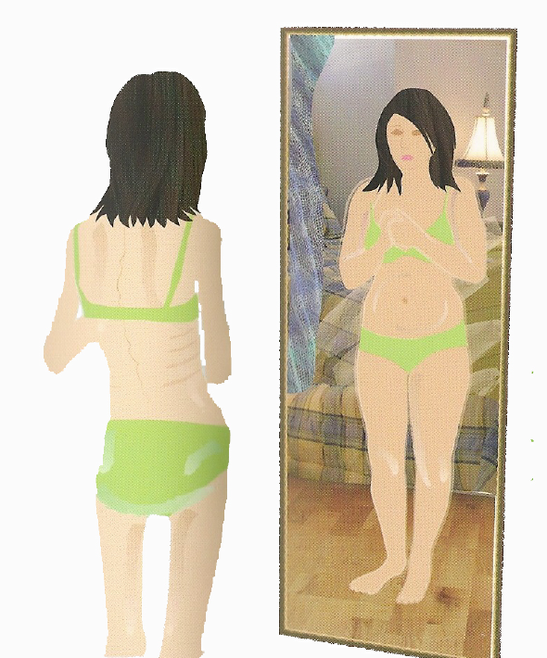
Except for those who are underweight, most pediatricians do not regularly screen for unhealthy weight control behaviors.
Fonseca H. et al.
Are Overweight Adolescents at higher risk of engaging
in unhealthy weight control behaviours?
Acta Paed 2009; 98: 847-52

Slide 64
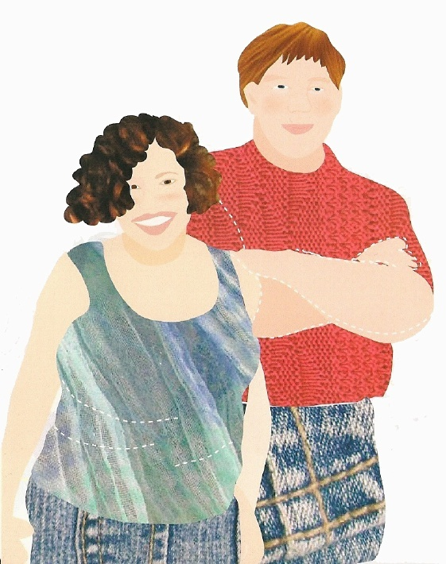
Fonseca H, Matos MG, Guerra A, Gomes-Pedro J
Acta Paed 2009; 98: 847-52
Special attention needs to be directed toward youth at greatest risk for disordered eating, including overweight youth.

Slide 65
Life Satisfaction
The Cantril ladder
Overweight and obese youth placed themselves on a lower step compared with non-overweight peers.
Fonseca H, et al.
Are Overweight and Obese Adolescents Different From Their Peers?
Fonseca H, Matos MG., Guerra A, Gomes Pedro J. Int J Ped Obes 2009; 4:166-174.

Slide 66
Physical and Emotional Health
Obese and overweight adolescents reported their health as fair or poor more often.
They were more likely than their peers to describe themselves as “unhappy”.
They reported irritability or bad temper more frequently.
Fonseca H, et al.
How much does overweight impact the adolescent developmental process?
Child: care, health and development 2010; 37 (1): 135-142.

Slide 67
Highlight the main components of a health promotion/obesity prevention program, targeting healthy eating and exercise among adolescents small group + plenary review

Slide 68
Unhealthy weight control behaviors
Negative impact on body image
Low self-esteem
Body dissatisfaction

Slide 69
Better socialization
Effective weight control
Increased
self-esteem
Increased body satisfaction

Slide 70
CHALLENGES IN THE ASSESSMENT
AND TREATMENT OF ADOLESCENT OBESITY
Individual context
Food
Exercise
Health
Nutrition choises
Activity choices
Life-styles
What we
know
What we
do
What we
feel
Emotions
Self-esteem
Body image
Helena Fonseca, 1999

Slide 71
References
World Health Organization Reference Curves
file:///C:/Users/Helena%20Fonseca/Downloads/ECOG-Obesity-eBook-World-Health-Organization-Reference-Curves%20(1).pdf
Community wide interventions for increasing physical activity. Cochrane Database of Systematic Reviews, 2015.
http://onlinelibrary.wiley.com/doi/10.1002/14651858.CD008366.pub3/full
Interventions for preventing obesity in children. Cochrane Database of Systematic Reviews, 2011.
http://onlinelibrary.wiley.com/doi/10.1002/14651858.CD001871.pub3/full
Psychological Assessment of The Obese Child and Adolescents: Principles
file:///D:/ECOG-Obesity-eBook-Psychological-Assessment-Of-The-Obese-Child-And-Adolescents-Principles.pdf

Slide 72
References
School and Obesity
http://ebook.ecog-obesity.eu/chapter-psychological-assesment-disturbances/school-obesity/?utm_source=text&utm_medium=article-link&utm_campaign=ebook-en
Maternal Child Health Program, School of Public Health and Community Medicine University of Washington
http://faculty.washington.edu/jrees/adolescentnutrition.html
European Food Information Council Child and adolescent nutrition
http://www.eufic.org/article/en/page/BARCHIVE/expid/basics-child-adolescent-nutrition/
University of Washington - Information on Adolescent Nutrition
http://faculty.washington.edu/jrees/adnutriinfo/adnutriinfo1.html

