Slide 1
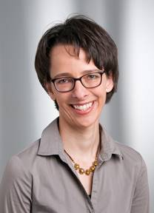
MIDI-CONFERENCE IUFRS
22 novembre 2018, 13 heures
Auditoire Nestlé Michaud
Prof. Dunja Nicca, PhD, RN
Institut für Pflegewissenschaft, UNIBAS
“ Theory of change for implementing seasonal influenza prevention in hospitals ”

