Slide 1

A Swiss Data Bank of
International Bank Data
1890-1970
Malik Mazbouri
UNIL – Université de Lausanne
2017

Slide 2
Why a data bank of bank data ?
A part of a FNS research project on the history of Swiss banks in the 20th century with Prof Sébastien Guex, UNIL and Rodrigo Lopez
2 main components :
    1) Qualitative – thematic component
    2) Quantitative – comparative component

Slide 3
The Database
Quantitative – comparative component
Red thread : Swiss « Big » banks
Main source : Official annual reports (more on that later)
5 European countries + Switzerland 1890-1970

Slide 4
The Database
Which countries ?
Great Britain (Dominant center)
Germany (Close relationship / Universal)
France (Close relationship / Competition)
Italy (Close relationship / Universal)
Belgium (Small competitive country)

Slide 5
The Database
Which equivalents / counterparts for the Big Swiss Banks?
« Big Bank » = statistical convention/invention (1915)
Larger than the others
Gathered in a specific cartel (1897)
Most of them are doing a part of their business abroad
Universal (multi-branch) banks
Make the heart of the banking system (systemic role / TBTF)

Slide 6
The Database
Which equivalents / counterparts
for the Big Swiss Banks ?
Great Britain : The Big Five
Germany : The D-Banken
France : Main commercial banks
Italy : Main commercial banks
Belgium : Main commercial banks
Notes:
Three main criterium Service d’études économiques de la SDN
Three main criteria
Banks ranking

Slide 7
The Database
What equivalents / counterparts
for the Big Swiss Banks ?
Similar position (+/-)
Durability
Tradition
Heart of their banking system at home
Last long enough to allow comparisons in the long run
Regularly compared to each other by institutions (LON 1930) or by leading publications (The Banker’s Almanach ; The Economist ; Der deutsche Oekonomist )
Notes:
Three main criterium Service d’études économiques de la SDN
Three main criteria
Banks ranking

Slide 8
The Database : Switzerland

Slide 9
The Database : Great Britain

Slide 10
The Database : Germany

Slide 11
The Database : France

Slide 12
The Database : Belgium and Italy

Slide 13
The Database
Number of banks by countries 1890-1970 (T=38)

Slide 14
The Database : 11 accounting items
Liability
1 Total liabilities (balance sheet) Total external funds :
2 Profit & Loss - 6 Due to banks
Total equity : - 7 Current accounts
- 3 Capital paid-up - 8 Other deposits
- 4 Reserves
- 5 Retain earnings (balance carried forward)
Asset
9 Assets (Total assets minus Contra acc.) 10 Due from banks
11 Contra accounts : Acceptances and endorsments
Off-Balance sheet operations (if avalaible)
A total of almost 30’000 entries

Slide 15
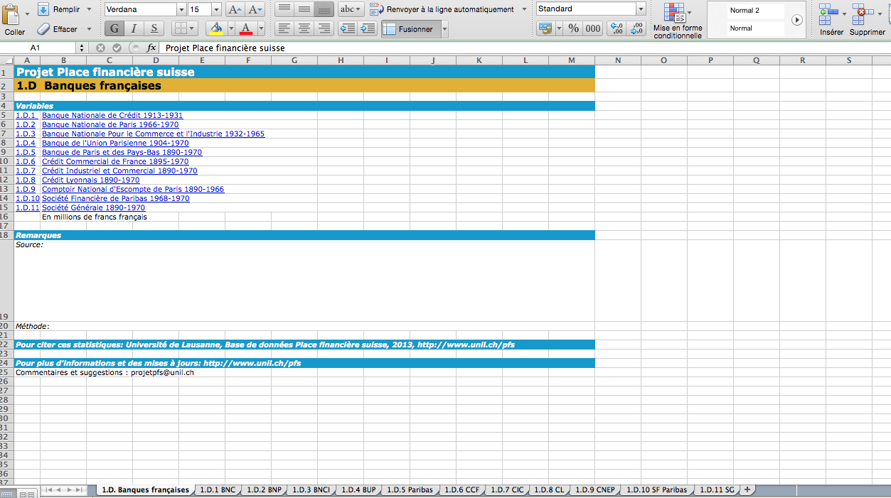
The Database : Excel sheet

Slide 16
The Database : Excel sheet
1 stack with
6 main sheets
1 stack with
5 secondary sheets
11 accounting entries
for the 38 banks and the 6 countries included in our database (1890-1970)
Data classified in 4 main accounting entries :
Total of the balance sheet
Total of the equity
Total of the external funds
Total of the profits & losses
for the 38 banks and the 6 countries included in our database (1890-1970)

Slide 17
The Database : some ratio
1) « Concentration » indicator
(% of the assets of our bank samples to the total assets of the national banking sector)
2) Share of the assets of our bank samples to the GDP (by country)
3) Share of equity capital to the balance sheet (leverage ratio)
4) Share of equity capital to the external funds (rough solvency indicator)
5) Share of profits and losses to the equity capital (rough rate of return indicator)

Slide 18
Example : Leverage ratio of the Swiss big banks in comparison to European counterparts (equity capital as a % of total assets) 1890-1970

Slide 19
The Database : other data
Total bank assets (by type of banks)
Consumer price index
GDP
Exchanges rates
For the 6 countries 1890-1970

Slide 20
The Database : some debatable choices
Published annual accounts
(no banks’ archive data)
    Window dressing ;
    Hidden reserve ;
    Profit smoothing ;
    Off-balance sheet operations ;
    Aggregation / Disaggregation of balance sheet categories ;
    No consolidated accounts ;
    Etc.
Notes:
- Bank data = a part of a bigger project ≠ the project itself
- Access (if permitted) to more than 30 bank’s account archives = impossible
- Data intramuros = hig level of heterogeneity in the internal accounting practice with big comparabilities issues.

Slide 21
The Database: some debatable choices
Published annual accounts (no banks’ archive data)
                “You are aware that the annual financial statements of a bank, such as they are presented to the public, are drawn up after having been trimmed […]. We are happy to tell you that, in our case, the result that we shall submit to you, which is the result that we will publish officially, gives a picture of only 50% of our actual activity”
                A Director of SBC, Basel 1938
Published annual accounts = « accounting fictions » (Bouvier)
Litterature and research suggest :
  Published and “real” results evolve +/- in relation to each other
  OK for establishing key trends
Notes:
- Bank data = a part of a bigger project ≠ the project itself
- Access (if permitted) to more than 30 bank’s account archives = impossible
- Data intramuros = hig level of heterogeneity in the internal accounting practice with big comparabilities issues.

Slide 22
The Bank Data : some debatable choices
Same deflator for all our accounting items
(Equity / deposit / profit and losses)
Transformation in CHF by annual average exchange rates
Then adjustment at constant price by the swiss consumer price index 1890-1970

